Slide 1

Year 11 Parent/Carer GCSE
Information Evening
Miss Bott
Head of School

Slide 2
Mrs Quirk
Vice Principal
English

Slide 3



Slide 4
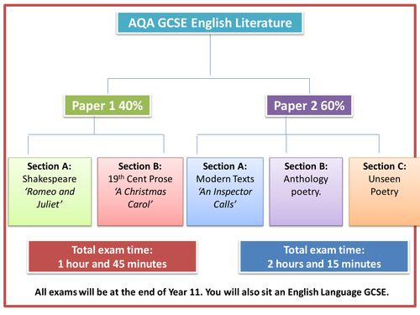
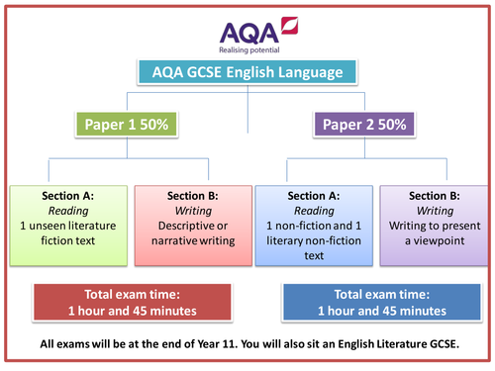
'Macbeth'

Slide 5
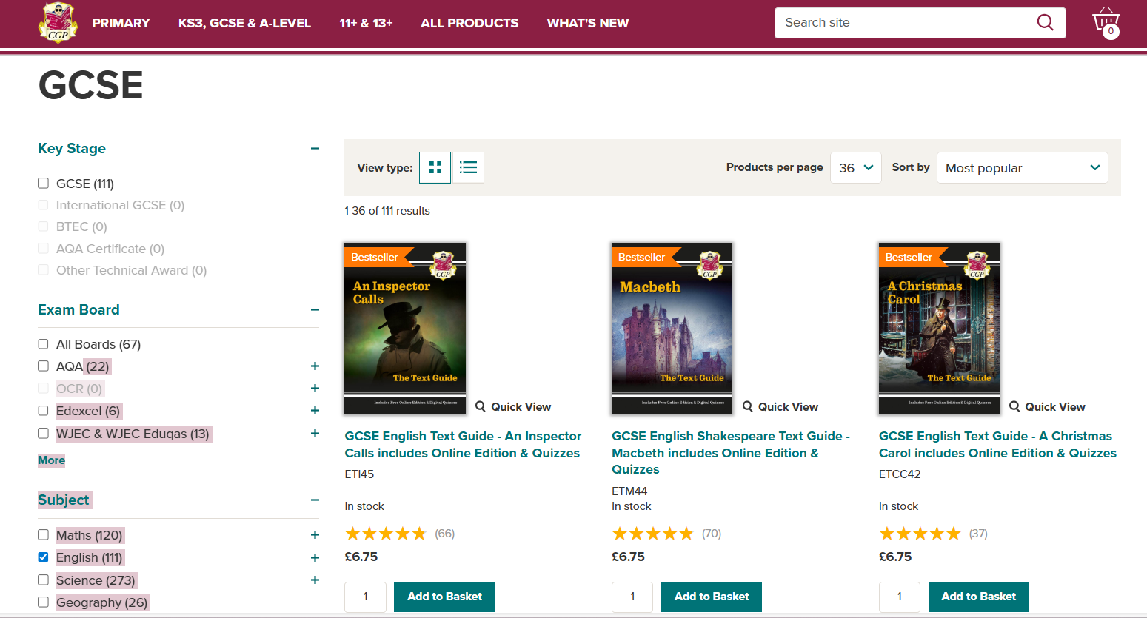
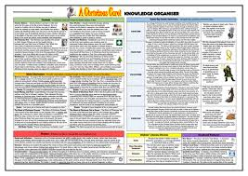
Resources
Knowledge organisers
GCSE Pod
YouTube
Revision guides

Slide 6

Flashcards

Slide 7
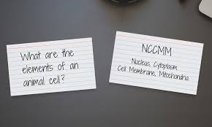
What?
Question or key term on one side, the answer or definition on the other
Don’t just copy huge chunks of text out!
Flashcard must work your memory (retrieval practice)
Keep information brief
Use different colours to categorise information
Brainscape/Quizlet

Slide 8
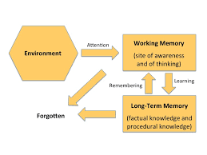
Why?
They make your brain recall information which helps information transfer form the short term to the long term memory
They make you cut down information to the key bits you have to know

Slide 9
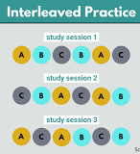
How?
Flashcards must be made and used in advance, not the night before an exam
Make them bit by bit (once you’ve been taught something)
Use each set in a spaced pattern and leave longer between each cycle. Keep repeating, even when you think you know it!
Once you’re more confident, you can mix and match topics to replicate an exam

Slide 10
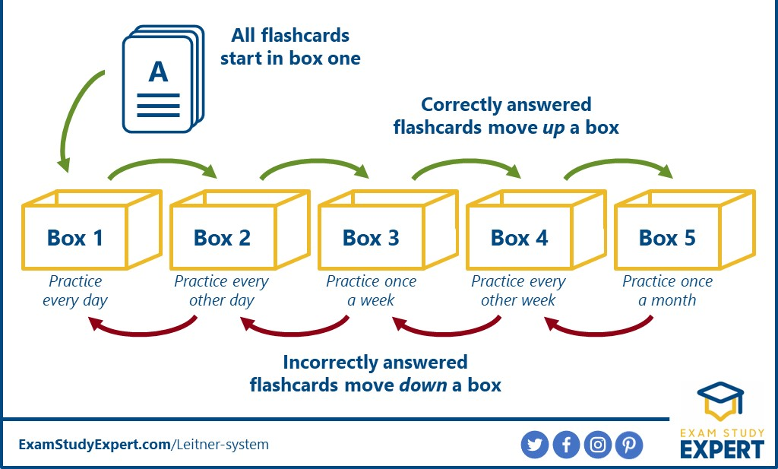
Letiner System

Slide 11
High Frequency topics
Language
Language analysis
Structure analysis
Evaluation – agree/disagree
Descriptive writing
Summary
Comparison
Transactional writing

Slide 12
High Frequency topics
Literature
Themes – greed, ambition, social responsibility
Characters
Unseen – aging, weather etc.

Slide 13
Mr Shergill
Assistant Principal
Maths

Slide 14
About Mathematics
There are two tiers:
Higher [Grades 9 to 4]
Foundation [Grades 5 to 1]
There are 3 exam papers, each 90mins:
Paper 1 [Non-Calculator, 80 marks]
Paper 2 [Calculator, 80 marks]
Paper 3 [Calculator, 80 marks]

Slide 15
How to support your son/daughter
Go through their strengths/weaknesses document with them
Ensure they know how to use their own scientific calculator – trig functions, pi, cube-rooting, etc
Use the best resources for independent learning:
Corbett Maths; Maths Genie; Maths Links

Slide 16


"Quizzing" - The theory behind it
Passive Review
  Being re-exposed to information again
  Re-reading the information we need to know
  Familiar words, layout, order
  Recognising information
Active Recall
  Pulling information out of our brains
  Under pressure – no help
  Checking afterwards
  Strengthens memory far more than just looking at notes
  Retrieving information

Slide 17
These things have limited impact
Passive Review
  Reading notes or flash cards
  Re-writing notes to make them look prettier
  Highlighting sections
  Copying a model answer
  Looking at examples without trying them ourselves
Active Recall
  Covering up notes; writing them from memory; checking
  Doing questions without notes
  A parent holding the notes or flash cards whilst asking their child questions from them
These have the greatest impact

Slide 18

A simple system to try (e.g. Maths)
Look at your list of weaknesses from the Maths mocks
Search for one of the topics on MathsWatch
Watch the introduction and maybe the first example
Pause the MathsWatch video clip at the next example, before it is demonstrated
Have a go at the question
Unpause the video clip and check your answer line by line
Identify any mistakes you made and try the next similar question in that video clip

Slide 19

"Quizzing" - Pro tips
Do 1 topic at a time
On each topic, do multiple questions on each topic until you are making no mistakes
Mark answers (and working) honestly
No notes, no help, no peeking
Keep a page in a notebook called My Mistakes
  Write the topic
  Write the mistake
  Write the fix
  Re-quiz that some topic weekly

Slide 20
Miss Davies
Assistant Principal
Science

Slide 21
What will be on your Science exams?
Biology Paper 1: Biology topics 1–4: Cell Biology; Organisation; Infection and response; and Bioenergetics.
Biology Paper 2: Biology topics 5–7: Homeostasis and response; Inheritance, variation and evolution; and Ecology.
Chemistry Paper 1: Chemistry topics 8–12: Atomic structure and the periodic table; Bonding, structure, and the properties of matter; Quantitative chemistry; Chemical changes; and Energy changes.
Chemistry Paper 2: Chemistry topics 13–17: The rate and extent of chemical change; Organic chemistry; Chemical analysis; Chemistry of the atmosphere; and Using resources. Questions in Paper 2 may draw on fundamental concepts and principles from Sections 5.1 to 5.3.
Physics Paper 1: Physics topics 18–21: Energy; Electricity; Particle model of matter; and Atomic structure.
Physics Paper 2: Physics topics 22–24: Forces; Waves; and Magnetism and electromagnetism (and Space Physics for Triple Science).
You will have at least one required practical question per paper
You will have to identify variables

Slide 22
Maths skills
30% - Physics
20% - Chemistry
10% - Biology
Substituting into equations and solving
Re-arranging equations
Graph skills – plotting and interpreting
Use the equation sheet in your Physics exams – free marks!
Use a calculator

Slide 23
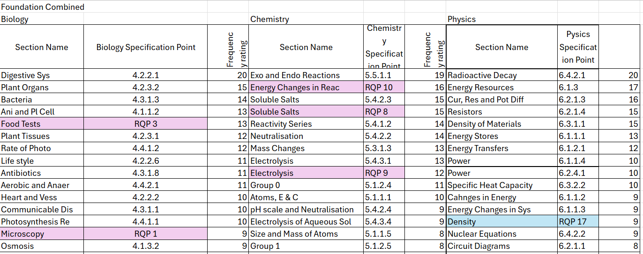
High Frequency topics

Slide 24
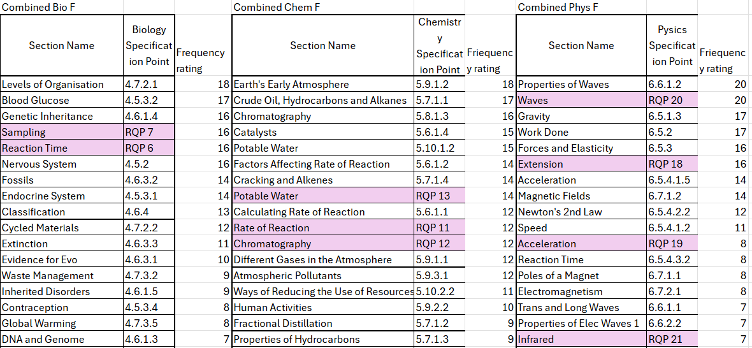
High Frequency topics

Slide 25
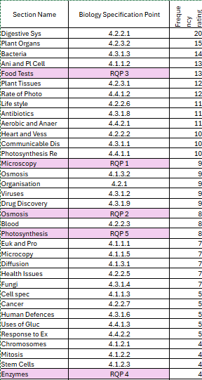
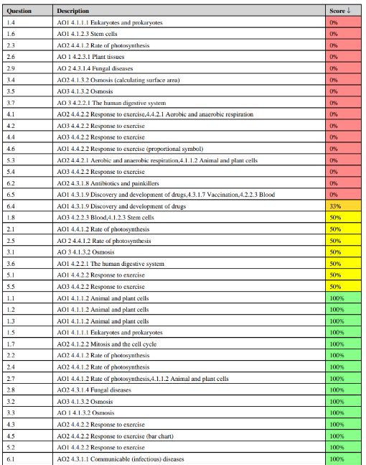
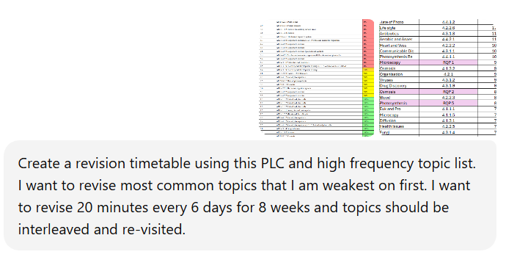
How to maximise your revision: revision timetable

Slide 26
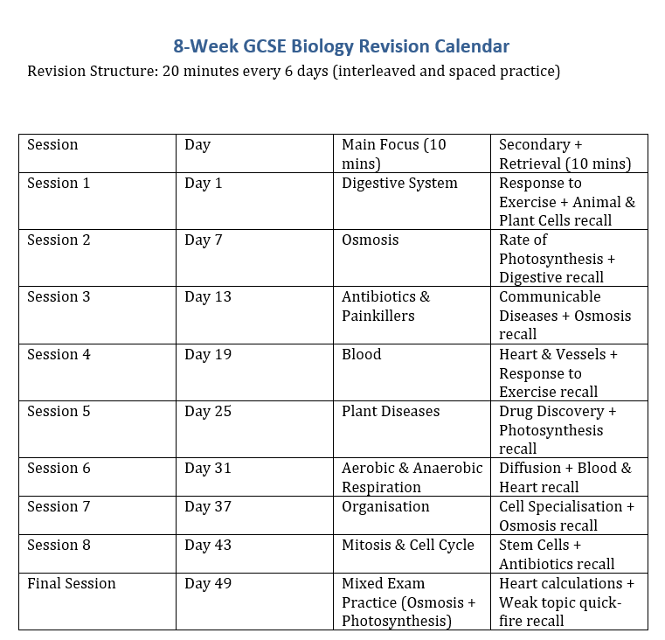

Slide 27
Useful websites
AQA website: specification and past papers
  GCSE Science 8464 | Assessment Resources | AQA
Physics and Maths tutor: exam questions, revision notes
  Physics & Maths Tutor
Save my exams: revision notes
  Revision Notes, Past Papers & Exam Questions

Slide 28


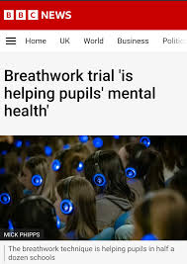

3D Breathwork

Slide 29


What support is available at
Gospel Oak School?
Mental Health and Well-being
Emotional and behaviour support
Pastoral support and guidance on personal issues
1:1 check ins
Regular contact with parents/cares
Mediation between peers
Maintaining standards through restorative practices
Key adult for support
Lesson visits
Academic support and guidance
Struggling to access learning
Key adult for progress/academic support/intervention/challenge
Careers aspirations and advice
1:1 Check-ins with students
Trusted adult
Regular contact with parents/carers
Maintain and implement standards of year group
Safeguarding
Head of Year
Year Team Lead
SEND Team
External Agencies
Resources
Police Liaison officer
Educational psychologist
Specialist teacher
Alternative provisions
Speech and Language therapists
Inclusion support
GCSEPod – Keeping Fit and Healthy
Extra curricular programme
Breakfast club
The Hive
Counsellor
WBA Foundation
John Liversuch
A trusted adult to speak to
One to one check ins​
Bereavement
counselling​
School counsellor​
E-safety​
Signposting to
appropriate support​
Liaising with
external agencies
Worry boxes
LGBTQ+ Counselling​
Regulating emotions
Anxiety workshops
Self esteem interventions
Building resilience
Supporting with communication difficulties
SEMH support
Regulation room
Parental/carer engagement
In class support

