Slide 1



Year 11 Pathways
P16

Slide 2

AFTER YOU FINISH YOUR GCSES, WHICH OF THE FOLLOWING FUTURE DESTINATIONS INTEREST YOU?
There are different Pathways available to you once you leave Year 11

Slide 3

How I can help you.
Ms Wilkins – Director of Careers
Organise careers events with teachers and external employers and organisations.
Ensuring you receive careers related education through curriculum and PSHE.
Provide 1:1 support to help you to make decisions
Let you know about the Labour Market – what jobs are in demand and which ones may not exist in the future.
Provide careers related information; e.g. colleges, apprenticeships, training programmes, Universities.
Support with choosing A level and GCSE Options
Contact on swilkins@crst.org.uk
'I'm not here to make your decision for you! The information and advice I give is to support you to make informed decisions about YOUR future. I'm also not here promote sixth form, my advice is independent.'

Slide 4
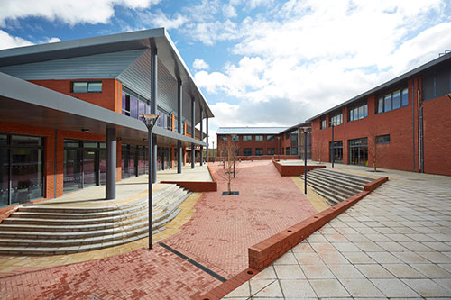
Today's assembly
Colleges
Sixth Form
Apprenticeships
Traineeships
Military Prep College
P16 Qualifications and what they all mean
University & UCAS
What is a Russell Group University?
Resources to help you
Ideas to develop your self
Your next steps
Q&A

Slide 5


Deciding what's best for you!

Slide 6

1. Sixth Form
2. Further Education Colleges
3. Apprenticeship
4. Traineeship/Pre-Apprenticeship
5. Specialist Provision e.g. Sports Scholarships, Military Prep
Your options after Year 11

Slide 7
Sixth Form
Sixth Form - a sixth form college is an educational institution in where students aged 16 to 19 typically study for advanced school-level qualifications, such as A-levels, BTEC and the International Baccalaureate Diploma, or school-level qualifications such as GCSEs.
Sixth forms, usually, prepare you for university or higher level apprenticeships or Employment
Gospel Oak
Dudley 6th
Central St Micheals
King Edward’s
Entry requirements are usually 5 GCSEs at grade 4-6 including maths and English. Some subject may require a higher grade – e.g. A Level maths or biology which require you to have a 6
Consider: Sixth forms operate like schools, limited subjects, 2 pathways A level or BTEC, you can go to ANY sixth form, staying on your own sixth form, teachers know you, familiar/family like environment, close to home. However you may want a fresh start, meet new people, may not have the grades to stay.

Slide 8
Further Education Colleges
FE colleges generally offer vocational (work-related) and specialist qualifications. Examples might include qualifications in construction, hair and beauty, animal care, travel and tourism, Game Design, etc. They tend to provide courses for 16-18 year olds as well as adult learners. FE colleges offer a wide range of courses at a variety of levels. There are also specialist colleges e.g. Music, Performing Arts
Sandwell College
BCU
Dudley College
Halesowen College
King Edwards is a college, but highly academic, for A levels only (6 GCSEs grade 6 or above)
Consider travel times, access to public transport, course content. Good idea to visit the Open Days and talk to the tutors. Good opportunity to make a new start.

Slide 9
Open Days Coming Soon
Gospel Oak – Thursday 26th October 5pm – 7pm
Dudley College 14th October / 13th January / 9th March
King eds Saturday 14th October 9am – 3pm
Check individual provider web sites for other dates.
Remember you can apply to as many colleges and sixth forms as you like

Slide 10
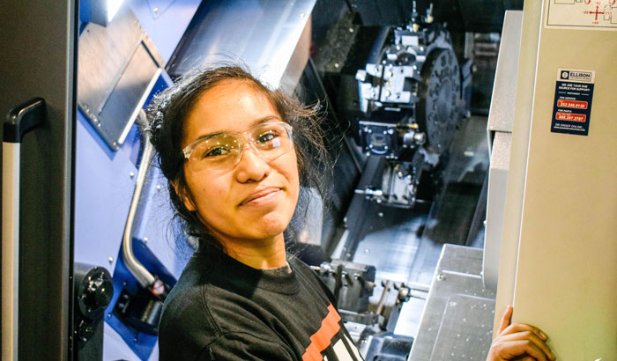
Apprenticeships
To get your career started you usually need a combination of experience and qualifications. An apprenticeship gives you both by combining on the job training with study (usually one day a week) meaning you can earn while you learn. (£3.90ph) With some apprenticeships you can even get a degree. It usually takes between one and four years to complete an apprenticeship depending on which level you take. Apprenticeships are available across a wide range of industries and many high-quality, prestigious companies offer them. Most employers insist on Maths & English GCSE minimum grade 4 or above
This is the website where most Apprenticeships are advertised
https://www.apprenticeships.gov.uk/apprentice/
You cannot start an apprenticeship until you are 16 or have left school after exams.
Consider: If your family claims benefits, you gaining an apprenticeship could affect this. Also consider travel, how will you get to your place of work? You have to apply like a job with an application, cover letter and interview – it's not an entitlement so be prepared to put in the work! You may work longer hours – 9-5pm, and then have to study in the evenings too! But the rewards are great, you gain a qualification and work experience. You can go to Sixth Form college and then onto an Apprenticeship.

Slide 11

Traineeship/
Pre-Apprenticeship
A traineeship (Pre-Apprenticeship) is an education and training programme with work experience that unlocks the great potential of young people and prepares them for their future careers by helping them to become ‘work ready’. Designed to help young people aged 16 to 24 who don’t yet have the appropriate skills or experience, traineeships provide the essential work preparation training, English, maths and work experience needed to secure an apprenticeship or employment.
Nova Training (West Brom)
Juniper Training (Wednesbury)
Skills Uk (Dudley)
Consider: Travel to a training provider. If you don't achieve the GCSE grades you need for an apprenticeship – this could be a good route. Smaller group sizes, therefore students with SEN or confidence issues could really benefit.

Slide 12

The Military Preparation College (MPC) is a unique training college that helps 16-19 year-old young people develop their fitness, vocational qualifications, and employability skills to help prepare for employment, including rewarding careers in the British Armed Forces. E.g RAF, Army, Navy.
Did you know there are lots of opportunties within the Armed Forces – including Apprenticeships?
Specialist - Military Preparation College
Consider: Not everyone is guaranteed a place in the Armed Forces after attending the college.

Slide 13

The course combines an academic qualification with football development, involving study for a BTEC Level 3 in Sport as well as weekly football training and representing West Bromwich Albion in the National Football Youth League (U19) against other professional clubs. Education takes place in The Hawthorns media suite, overlooking the pitch, with fitness training sessions at Xercise4Less and Central Campus. The football element is run by The Albion Foundation, and is delivered by UEFA B Licence Coaches who have direct links to WBA Academy and Scouts. You will participate in an average of 14 hours of teaching, 9.5 hours of coaching, 1 fixture per week and 2 hours of volunteering at The Albion Foundation.
Specialist - Football Academy
You'll need four GCSEs at Grade 4/C or above, including English and Maths, you'll also need to pass assessment at an open football trial.

Slide 14

Questions?

Slide 15
A Levels
A-levels are the most common step-up from GCSEs. They normally take two years to complete, full-time and are at Level 3 on the National Qualifications Framework (NQF).
Students usually take A-level qualifications in Year 12 and 13, after completing their GCSEs.
You would usually need at least five GCSEs at grades 9 to 4 to be able to study A levels.
Some schools require you to have grade 4 or above in English and Maths, or grade 5/6 or above in the subject you want to take. E.g. biology or maths
You usually choose the A-levels that you wish to study in Year 11, but you do have the chance to change your choices after receiving your GCSE results or after a week or so of the course if it is not what you expected.
There is a wide range of around 80 subjects available, although exact courses on offer will change depending on the college or sixth form you choose.
Most popular entry requirement for Universities and UCAS points

Slide 16
BTEC
Qualifications
BTECs are vocational, work-related qualifications that aim to engage and inspire learners in a wide range of subjects.
BTEC Nationals are Level 3 courses that are usually studied full-time at college or sixth form.
Some colleges may ask you to complete a Level 2 before progressing to a Level 3 course e.g. Engineering or Electrical Installation or if you don't achieve a L4 in English & Maths
You will also take part in work experience which will help you understand how your new skills apply to real life work situations. BTECs develop more practical knowledge and provide a different approach to learning, based alongside a theoretical background
BTEC Nationals are widely accepted at many Universities as part of entry requirements

Slide 17
T Levels
T Levels are a new, 2-year qualification designed to give you a head start towards the career you want.
The government has developed T Levels to deliver world-class technical education and give you a new choice after GCSEs.
A T Level is a nationally-recognised qualification that is worth the same number of UCAS points as 3 A levels.
Endorsed by business, they include a 45-day industry placement to help you learn what a real career is like.
    T Level Digital
    T Level Construction
    T Level Education & Childcare
    T Level Health & Science
    T Level Engineering

Slide 18
City & Guilds
The City and Guilds of London Institute (City & Guilds) is an examining and accreditation body for vocational, managerial and engineering training. They offer a large number of qualifications across 28 sectors, which are valued by employers in the UK and internationally. City & Guilds qualifications help individuals enhance their talents and enable them to improve their abilities for better career progression opportunities.
You would generally study City & Guilds Qualifications as part of an Apprenticeship

Slide 19
Questions?

Slide 20
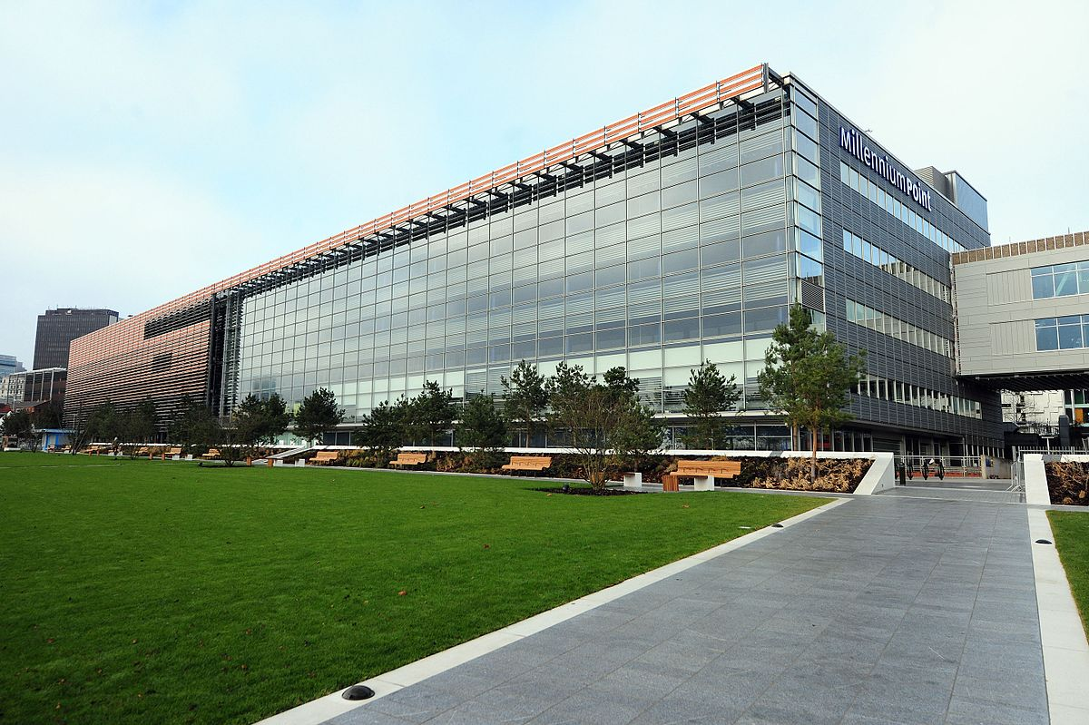
University After P16
A higher-level educational institution in which students study for degrees and academic research is done. University is, usually, attended after students have completed suitable Level 3 qualifications such as A Levels, T level, BTECs etc. Undergraduate -An undergraduate is a student at a university or college who is studying for his or her first degree. (BA, BSC Hons)
Universities offer a WIDE range of courses for ALL abilities – Journalism, Sports Coaching, Film Maker, Chef, Property Developer, Social Media,
Postgraduate - a postgraduate student is anyone who is studying a postgraduate course, including a masters course (MA, MSC)
Degree apprenticeships may fund a young person’s part-time university degree at the same time as getting paid for working in a job.

Slide 21
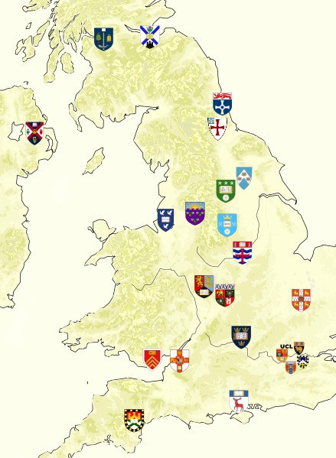
Russell Group University P18
The Russell Group represents 24 leading UK universities which are committed to maintaining the very best research, an outstanding teaching and learning experience and unrivalled links with business and the public sector. Highly academic.
Students expected to achieve A & A*s at A Level to gain places at these Universities (7,8,9 at GCSE)
Some Russell Group Universities will make allowances for example if you are on free school meals or if your parents never went to University.
https://russellgroup.ac.uk/about/our-universities/

Slide 22

UCAS
Universities and Colleges Admissions Service
It's the centralised service that students use to apply to university. ... Think of UCAS as an online dating service: through it you can select and apply to universities, the universities take your proposal and decide whether or not to offer you a place.
This involves writing a 4,000 word statement on why you want to attend University, what makes you a good candidate.
UCAS Points are awarded to students based on their results, for example an A Level grade A*= 56 points, B=40 points, C=32 and so on.
So when a university asks for 96 points for their course, you should know they are looking for around an CCC
BTECs also are awarded with UCAS points. D*=56, D=48, M=32, P16. If you get passes from most of your courses, you may need to consider a foundation level/access course at University.
UCAS POINTS CALCULATOR

Slide 23
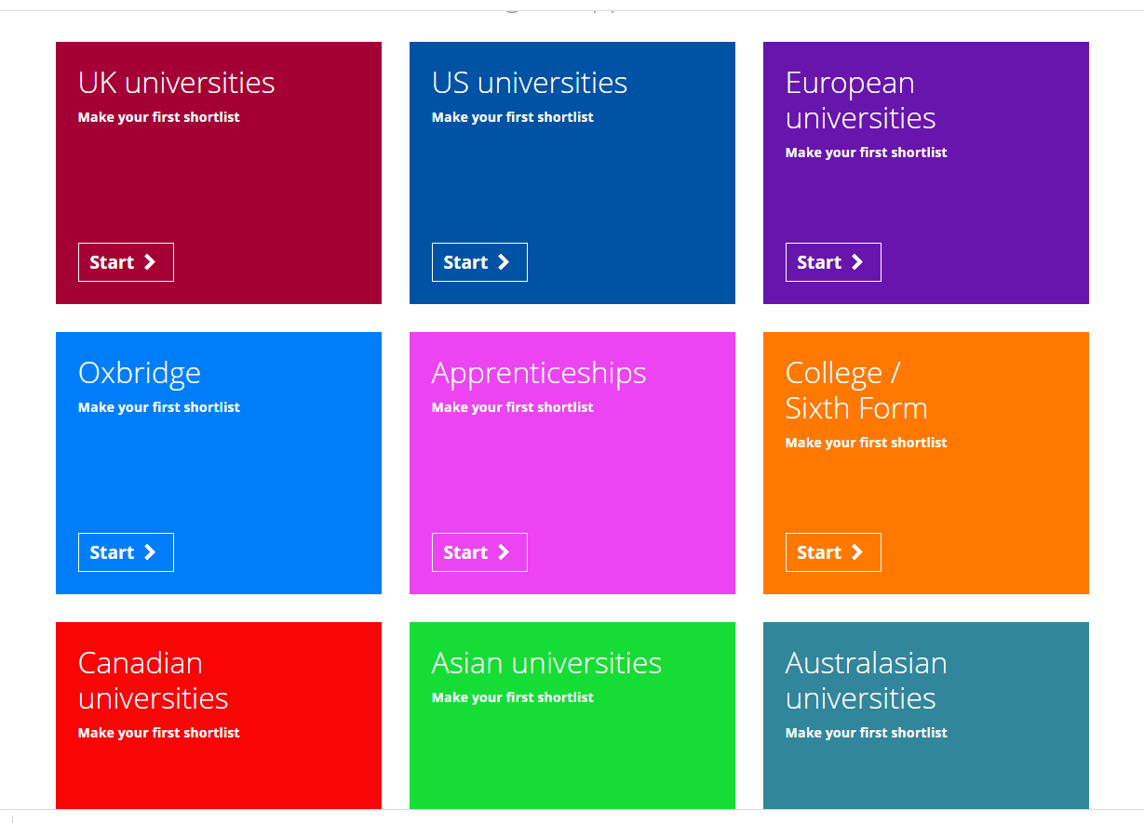

Slide 24
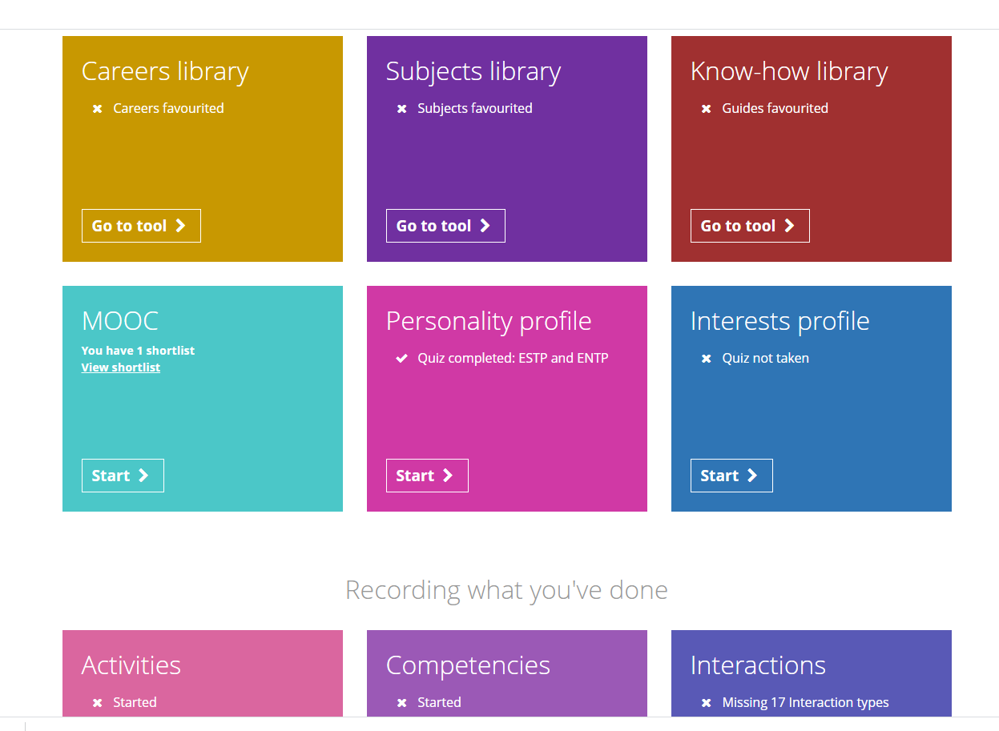

Slide 25

Useful Websites – Boost your application
https://www.springpod.co.uk/ - Virtual Work Experience, Apprenticeship Opportunities, University degree course taster sessions.
https://www.s4snextgen.org/ - Speakers for Schools, Virtual Work Experience, Talks
https://www.futurelearn.com/ - Online courses from Top Universities and Industries from across the world.
https://www.unitasterdays.com/ - All University events in one place
https://young-professionals.uk/ - Everything you need to find apprenticeships, work experience & insight days

Slide 26
Next Steps
Log
Log onto Unifrog to start research/make shortlists/finalise what you want to study
See
If you want to go to University, see what their entry requirements are e.g. if you want to study medicine at Uni you need A level Biology
Visit
Visit College/Sixth Form websites to find out when their 'Virtual Open Days' are, see what their application process is, deadlines.
Explore
Explore what Gospel Oak Sixth Form are offering, our teachers know you the best
Meet
Meet with me Miss Wilkins if you have any worries are really unsure about next steps, but demonstrate that you have conducted some research using the tools you have.

Slide 27
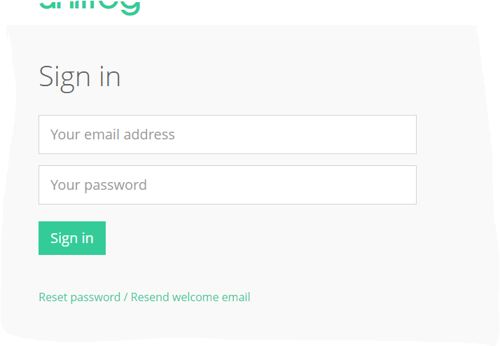

Unifrog LOG IN
Email address from Gospel oak
USE this along with your existing password.
stu.n.singh@gospeloak.co.uk
IF YOU HAVE FORGOTTEN YOUR PASSWORD
Click 'reset password'
Email will be sent to your account
Your email has now been changed to
Stu.n.singh@gospeloak.co.uk - sign in on office 365
Click on Unifrog email and reset password

Slide 28
Questions?

