Slide 1
Task 2 – Equipment and technology required for participants to use when taking part in sport and physical activity.
Name: BK

Slide 2
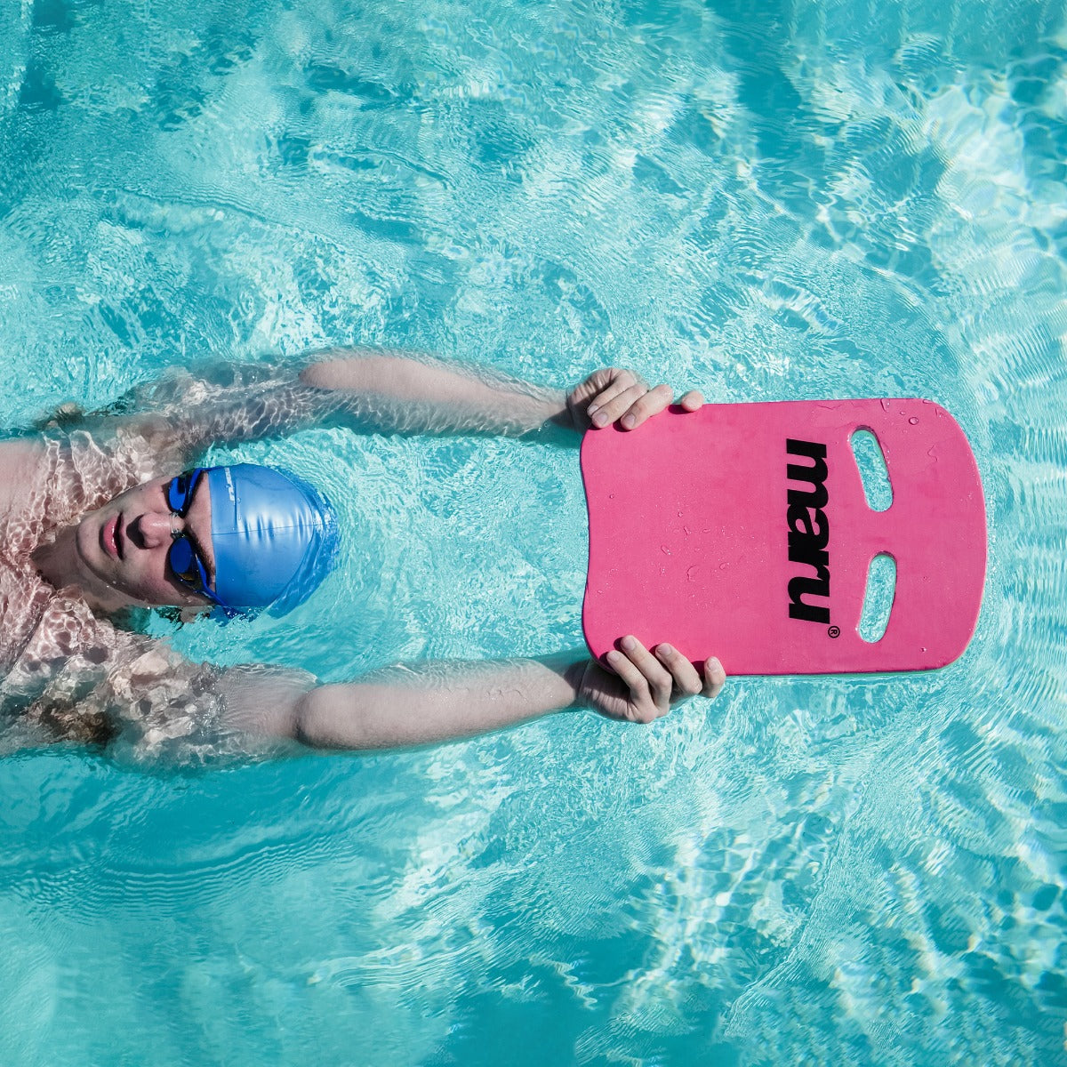
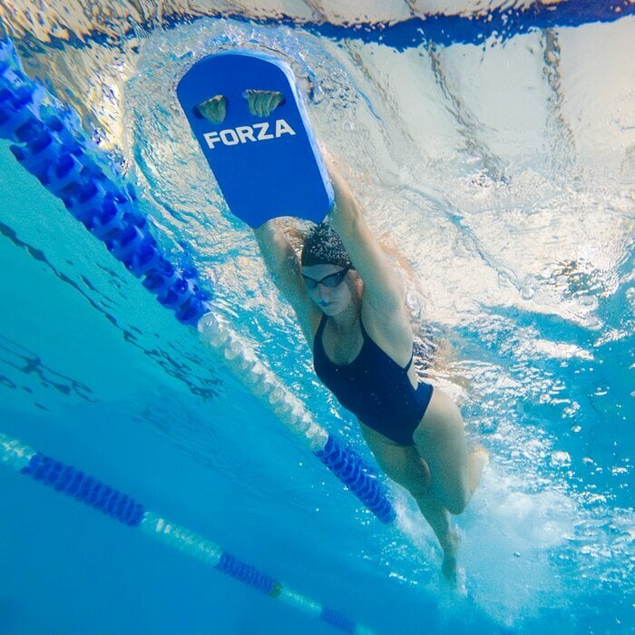
Swimming equipment
Kickboard
One equipment I suggest for darnel is a kickboard, which is a foam board used to help a beginner in swimming for balance and supporting their upper body. This piece of equipment helps darnel as he is a beginner and additionally, he will feel safe with having equipment on him and will learn faster. It develops his lower body as the focus is of kicking and the lower body to hold balance which is important for swimming as you may have balance to be able to swim and if not, then darnel will drown and his body won't adapt to swimming. Using a kickboard will help darnels lower body adapt to swimming, kicking and holding balance. Therefore, if he could focus on his lower body and then can focus on his upper body after. Additionally, using a kickboard it could help darnel improve his leg strength and techniques of kicking and lower body performing. Therefor kickboard is the best option for darnel.

Slide 3
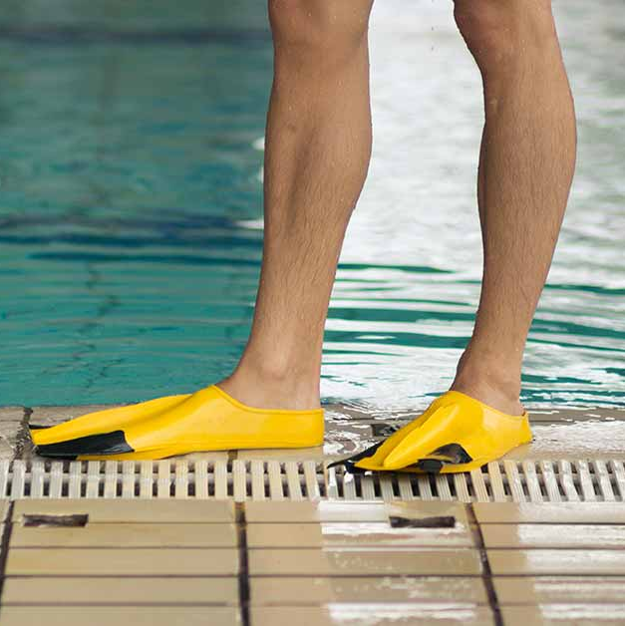
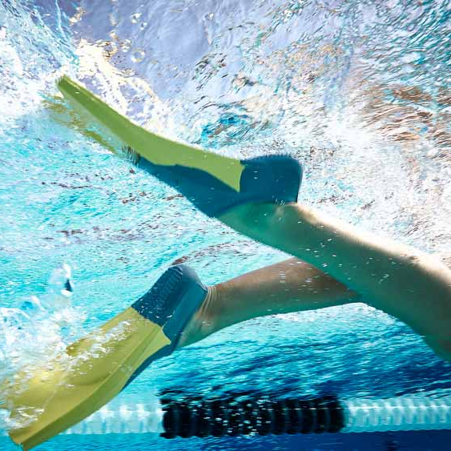
Swimming equipment
Fins
Another equipment I suggest for darnel is fins; these are flippers that are used by swimmers to move efficiently and faster in the water. This piece of equipment helps darnel as he is a beginner and doesn’t know how to swim and doesn’t have any techniques of being in the water. Additionally help darnel ankle flexibility and improve his body position underwater. It develops his speed and intensity used when swimming or do any movement this is important for swimming because you may have speed to be able to swim efficiently without losing balance, to be able to swim for a long period of time without getting tired to easily. Using this regularly will help him adapt to the speed and will be able to increase speed more. Additionally, fins also increase resistance to build lower body endurance.

Slide 4
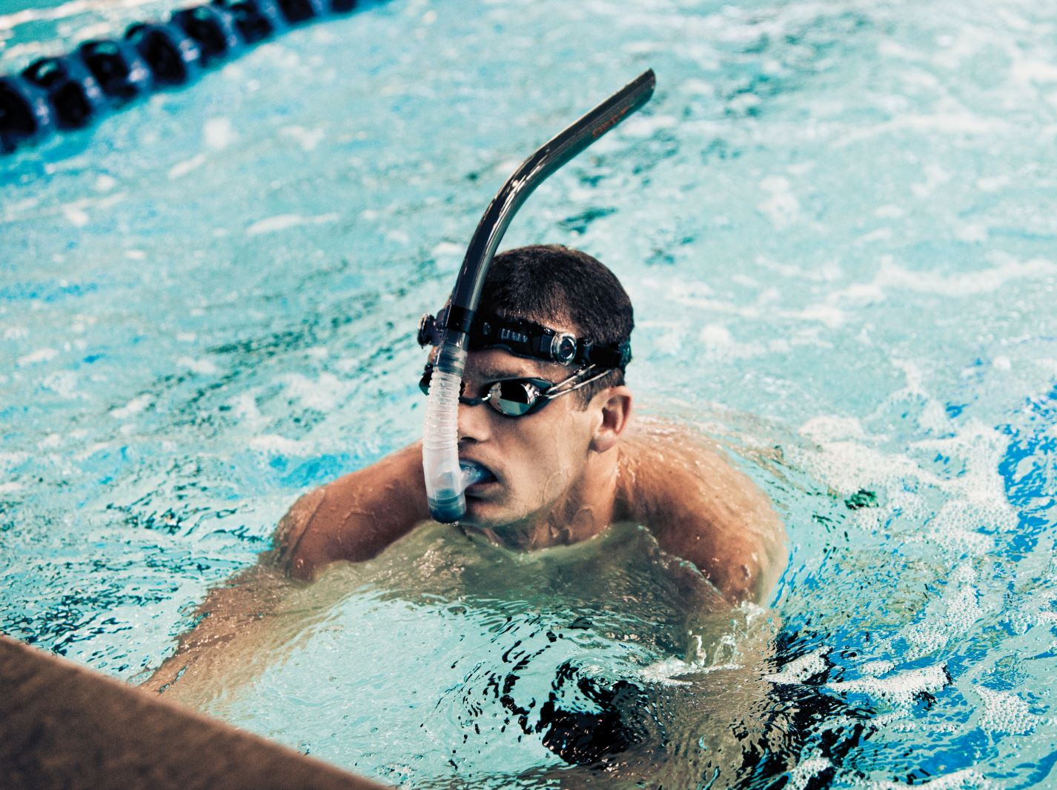
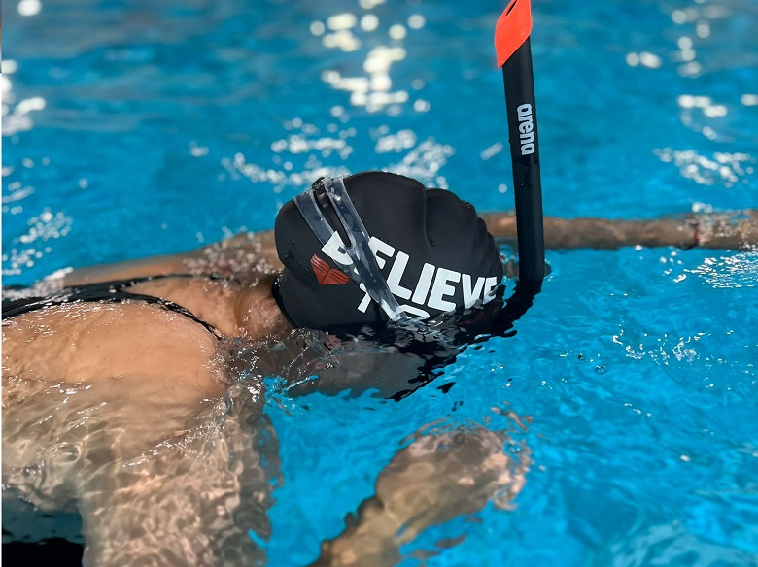
Swimming equipment
Snorkel
One of more equipment I suggest for darnel are snorkels. Snorkel are training aids that allow swimmers to breath, while keeping their face under water. This piece of equipment helps darnel as it helps move easier and faster efficiently. Also help swim for a longer period as they don’t have to worry about breathing. It develops his skills as it helps maintain good posture and consistent arm movement. Which is important for swimming because they may have a good posture to swim so their body can breathe effectively. Also, snorkels are affordable so there won't be a financial barrier for darnel. Using this regularly will help his body adapt to swimming for a long period of time without any pause. Therefore, snorkels are the best option for darnel.

Slide 5
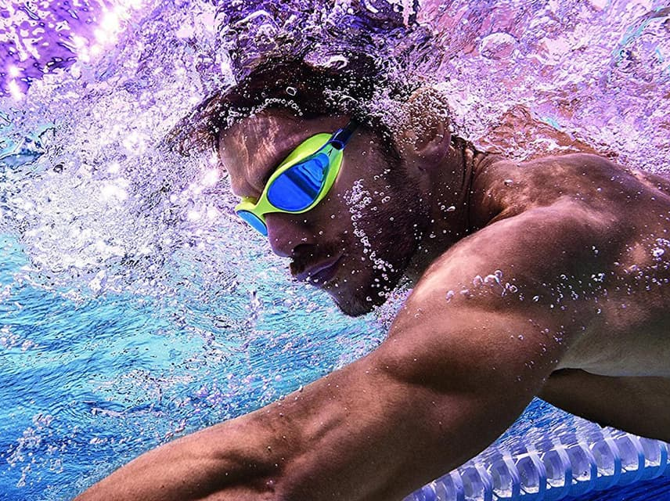
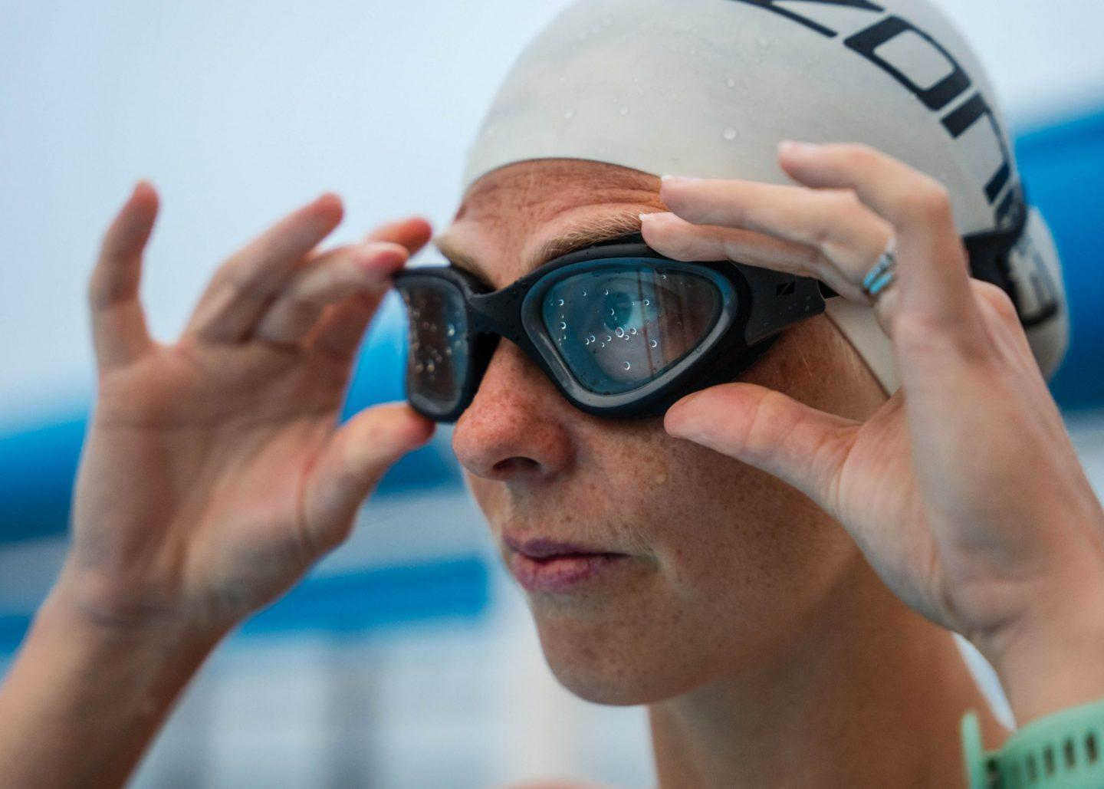
Swimming clothing
Goggles
The clothing that I suggest for darnel is Goggles. Goggles help protect the eyes underwater from chlorine, splashes and any little dirt in the water and help see clearly under water. This item is suitable for darnel as he is a beginner and may have trouble to keep his eyes closed, also may struggle when chlorine hits the eyes. Goggles help as they improve vision underwater and let individuals swim for a longer period of timer without pauses. It allows darnel to move comfortably and train effectively as their eyes won't burn when they been splashed by water and will be able to see under water, therefore will be able to swim for a longer period. This is why goggles are the best option for him.

Slide 6
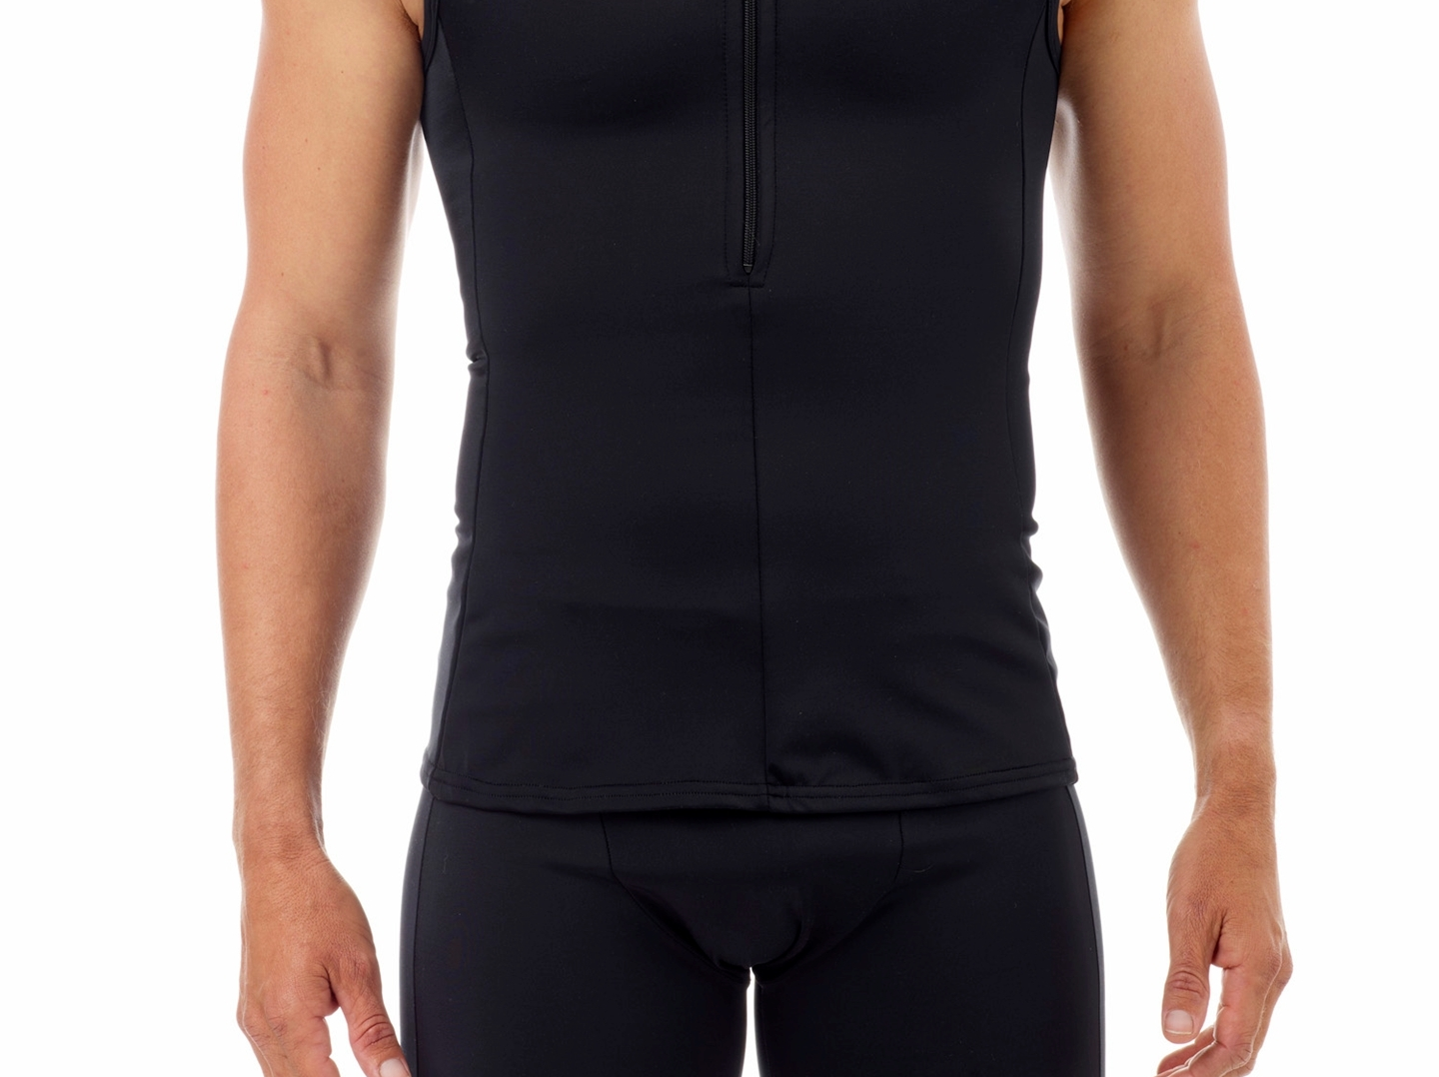
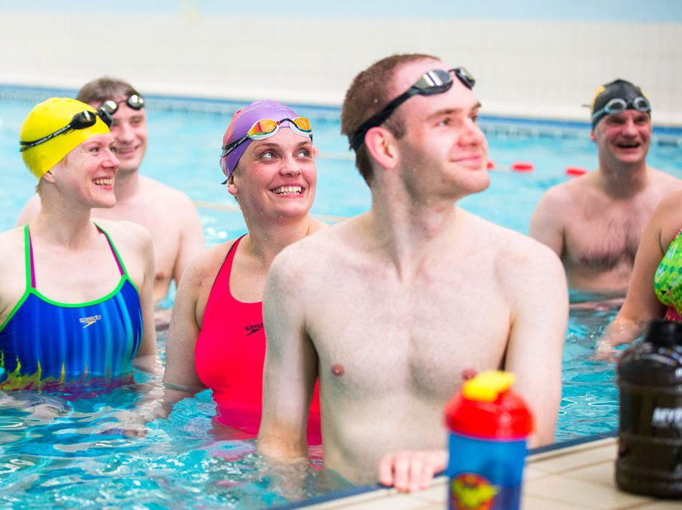
Swimming clothing
Fitted top
The clothing I suggest for darnel are fitted tops. Fitted tops will help darnel move faster and effectively, also will protect his skin from chlorine and provides a streamlined fit. This item is suitable for darnel because he will feel confident and comfortable wearing it because he feels low about himself and has insecurities around his body, therefore this will boost his self-esteem as Fitted tops are beneficial since they emphasis the body's natural shape. Also fitted tops help move faster while swimming as fitted tops are designed to reduce drag and friction under the water. Additionally, it will allow him to move comfortably and train effectively. Therefore, fitted tops are the best option for darnel.

Slide 7
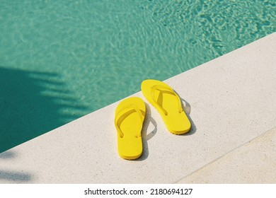
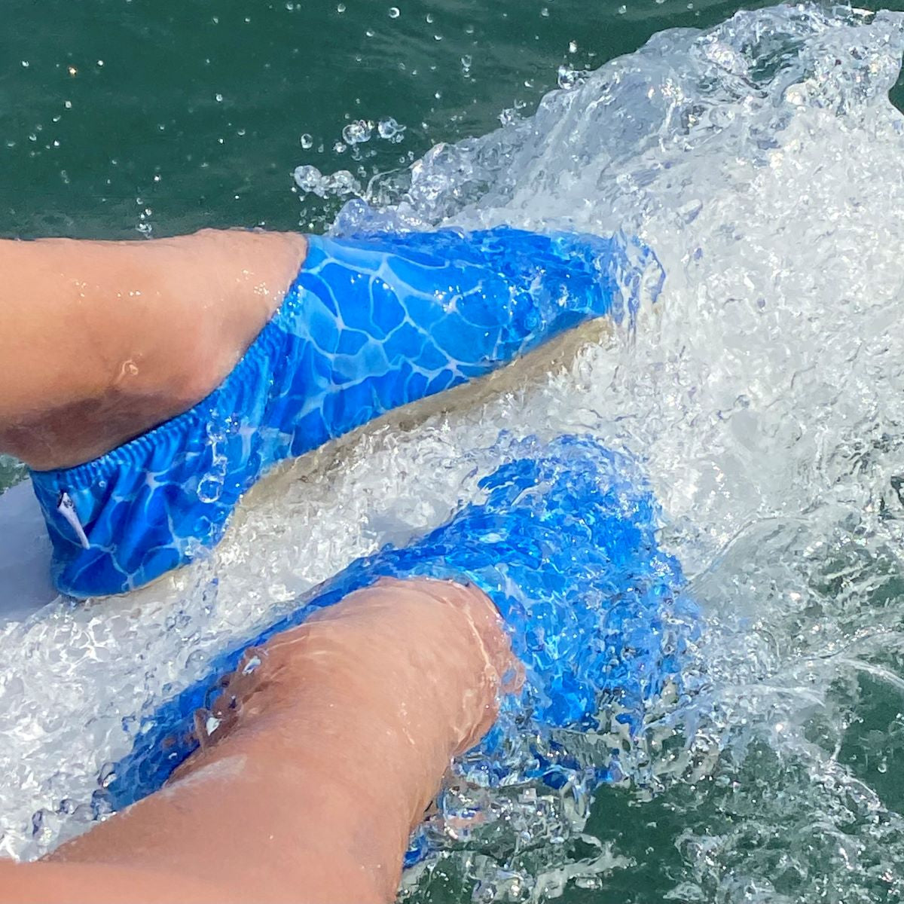
Footwear
Poolside slippers
I suggest poolside slippers for darnel. Poolside slippers are slippers, which will be placed just by the pool to be worn after swimming to prevent an individual from slipping. These slippers will help prevent any injuries, also help maintain hygiene from any bacteria outside and around the pool by others. Darnel needs this footwear as its best for safety and comfort around the pool, additionally if he doesn’t get injured, he may not consider doing it again, therefore won't lose weight. Also, as he hasn’t done swimming before he may feel more comfortable by wearing slippers instead of being barefoot. It helps him to stay safe as slippers will prevent him from slipping form the wet floor and will protect him from catching bacteria by the germs that came of other feet. The grip allows him to have balance and be able to walk without being worried about slipping. Therefor slippers are the best suggestion for darnel.

Slide 8
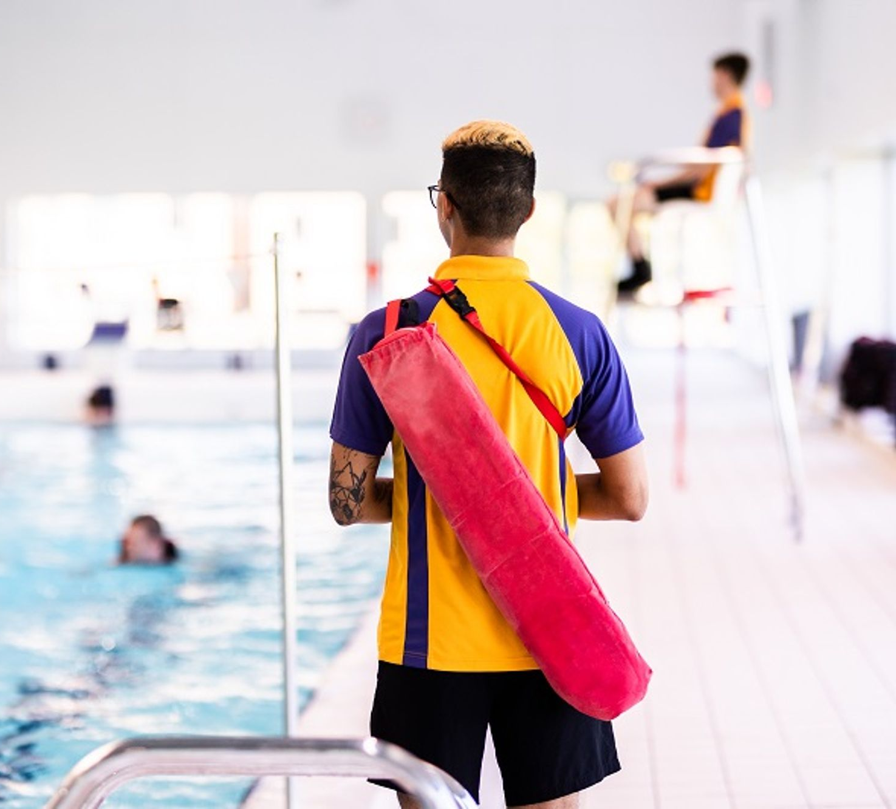
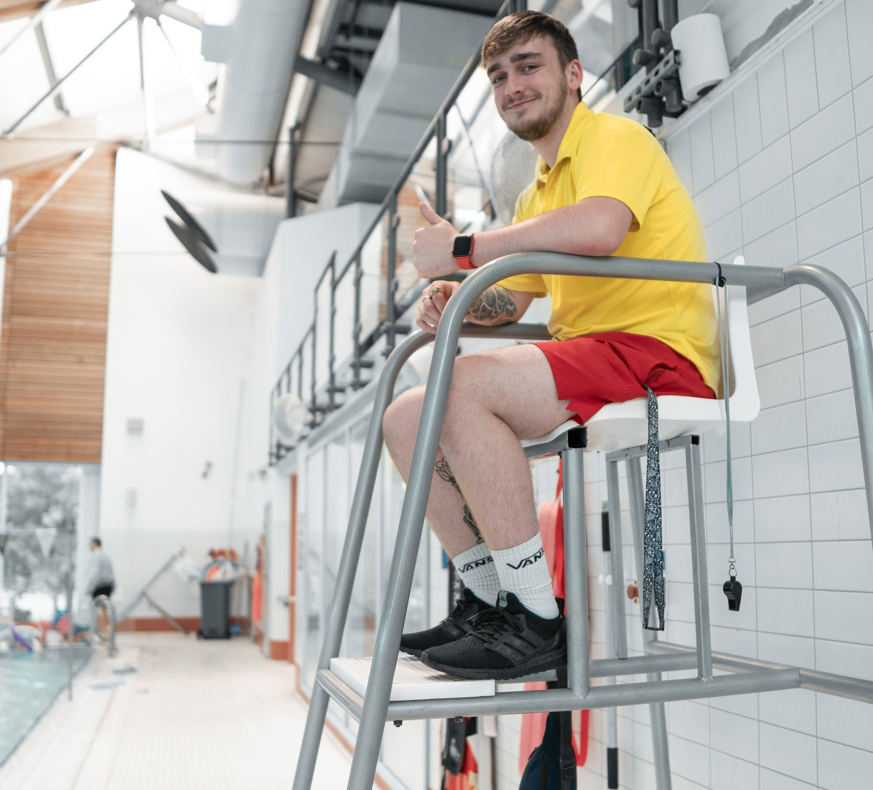
safety
To prevent injury darnel must follow key safety rules. One safety rule he must follow is to make sure a lifeguard is present when about to swim. This is important because he has inly start swimming as a beginner therefore, he isn't mastered in it and must have supervision for support at times. This rule will prevent him from getting injured and drowning s if he is having breathing problems when swimming, a safeguard must help him to prevent drowning and losing consciousness. Following this safety advice helps to ensure safety of darnel and him feeling safe when trying to swim as he knows someone will help him. Another safety rule he must follow is to warm up properly before entering the pool to prepare muscles. This is important because if he warms up, the blood will flow around the body therefore he won't get injured easily. This rule will prevent straining muscles and any injury. Following this safety advice helps to ensure safety and not injuring themselves and will prepare the muscles.

Slide 9
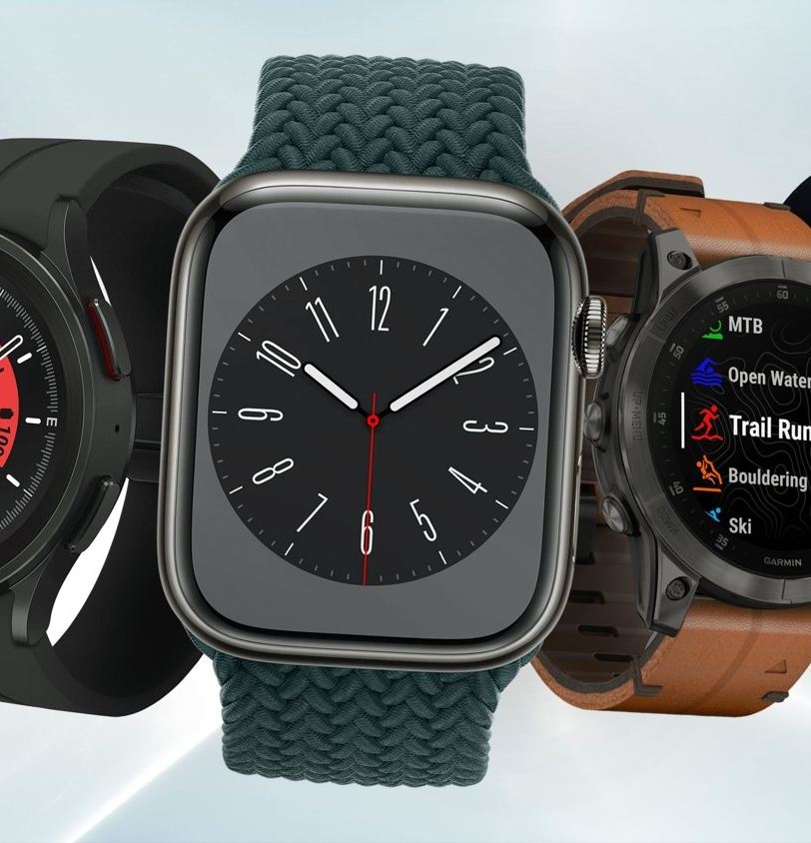
Technology
One technology I suggest for darnel is a smart watch. Some beneficials of a smart watch are that it can track the distance, time, pace and the calories gained or lost. Darnel should use a smartwatch as he is overweight, and he is able to see if the activities and sports are working to lose weight. Darnel will have a benefit as he can track his body to see if he has maintained it well. However, the limitation of using a smartwatch could be that he may be too focused onto the smart watch and the numbers shown and may be very insecure and get low self-image and he also may be too focused on it and overdo it. Also, he may not be able to afford it as smart watches can be expensive.

Slide 10
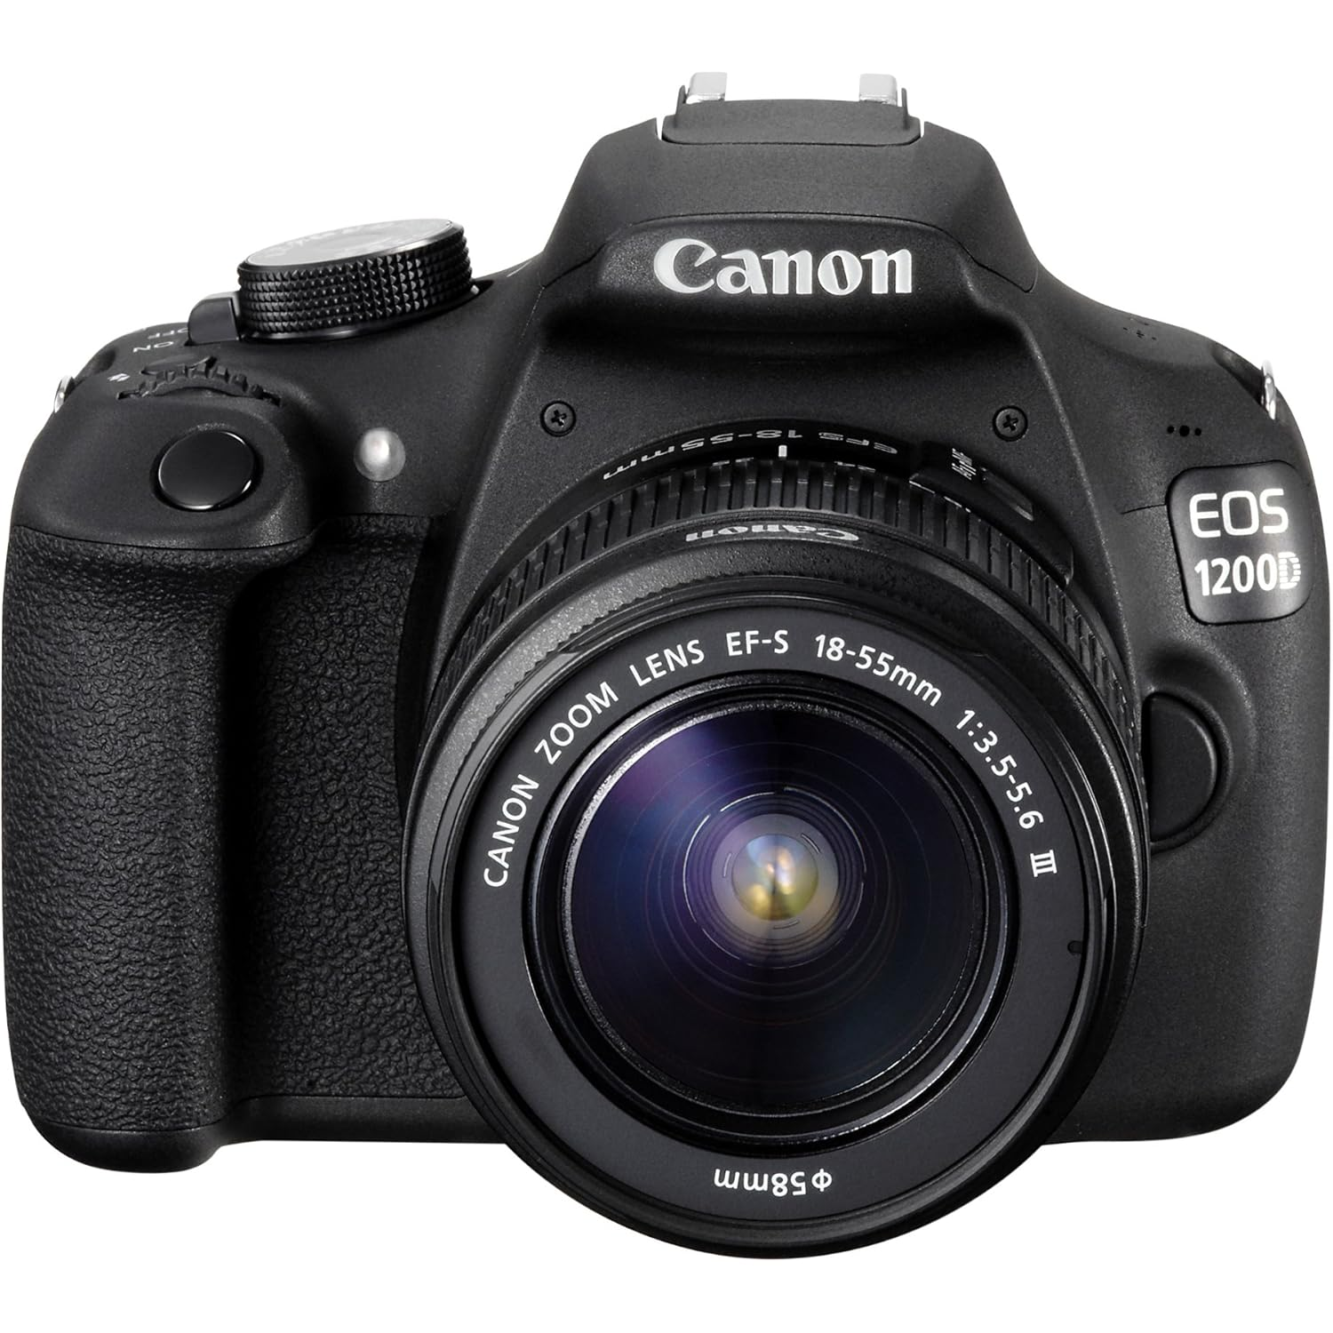
Technology
A technology I suggest for darnel is a camera. A camera will help record his swimming. The benefit of using a camera is that it will analyse darnels body alignment and his breathing. This technology will help track his improvement as he could see the difference between the before and after, also he could see what he could improve on from his swimming and tennis techniques. A limitation of using a camera could be that it requires to spend time, however darnel is a very busy guy, also it can be costly as it can be 500 to 1000.

Slide 11
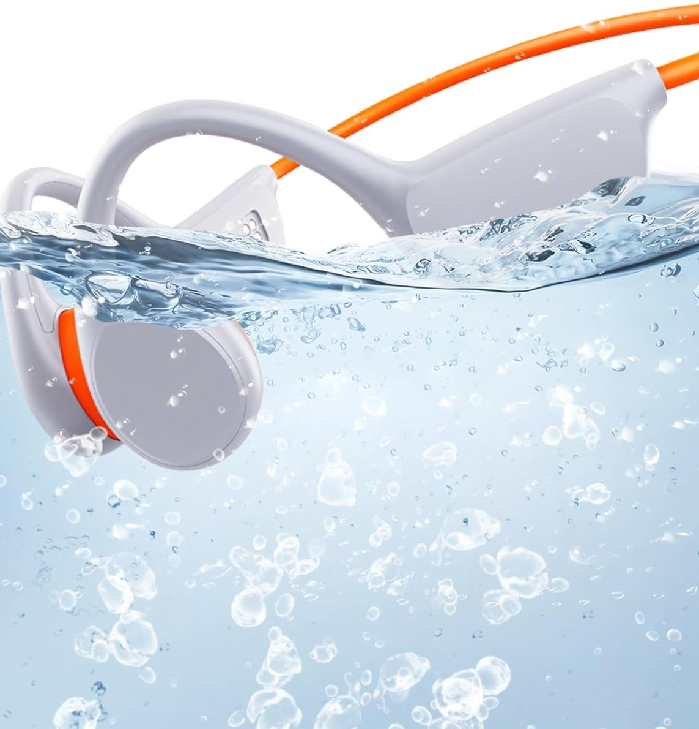
Technology
A technology I suggest for darnel are underwater headphones. Underwater headphones are waterproof and are hard to get damaged. The benefit of using underwater headphones are that he can be focused on the swimming and tennis instead of getting distracted by other noises. However, some limitations are that they may be expensive as they are waterproof, also sound quality may be reduced underwater.

