Slide 1
Task 2 – Equipment and technology required for participants to use when taking part in sport and physical activity.
Name: MS

Slide 2
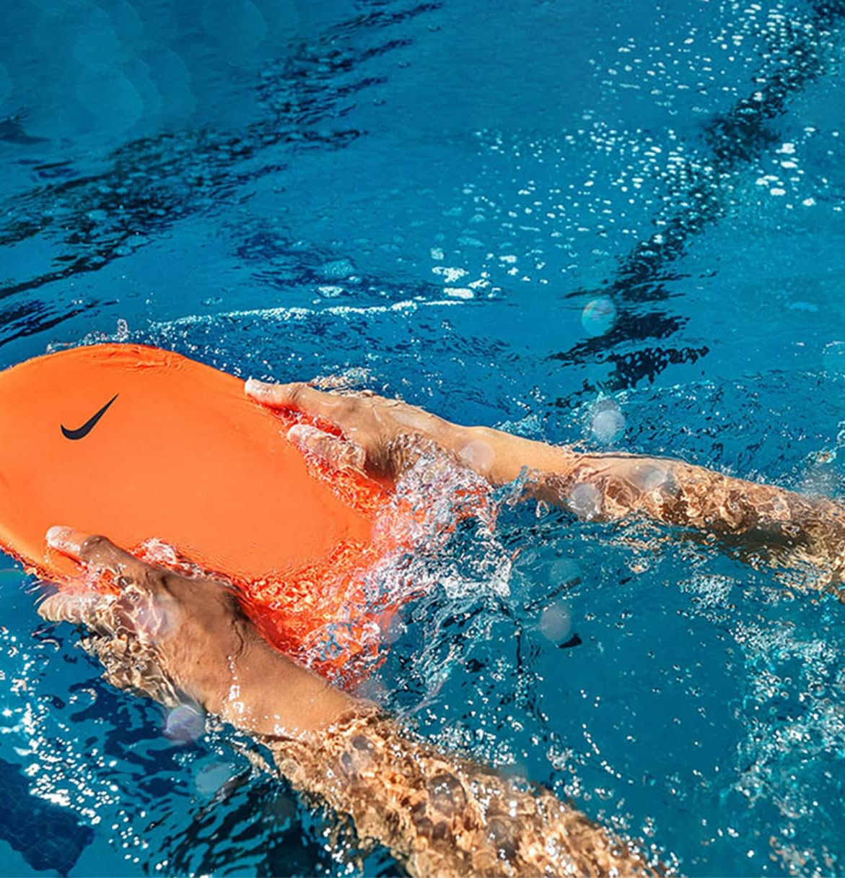
Swimming equipment
The swimming equipment that would be suited for Darnell would be a kick board. This would help the arms and upper body allowing a swimmer to focus solely on their leg movements and kicking technique. It helps build leg strength, endurance and power by isolating the lower body muscles such as calves, hamstrings, glutes and helps maintain a proper streamlined body position in the water. This will help him improve his performance as it is a helps him start off and allows him to learn slowly on what to do. Using this regularly will improve their leg strength by isolating the lower part of the body increasing the power. This will benefit all levels of swimmers as it is a basic skill starting small and increasing. This will help Darnell because it will help his leg strength and his body position. One benefit for this is it's an isolation of the leg muscle. One limitation is it can lead to bade posture which is not very ideal for him as he is already worried about his self-image.
The next piece of equipment would be fins. These are worn on the feet to increase propulsion and speed through the water which helps swimmers develop leg strength and improve kicking mechanics. The added surface area also helps improve ankle flexibility and allows swimmers to maintain a better body position and focus on other aspects of their stroke, such as hand entry and pull at a higher speed. It will develop leg strength improve kick technique and enhance body position in the water. Which is important for swimmers because it will improve techniques and gradually increase strength in the legs. This will help Darnell because it Improves his endurance and his performance. One benefit for this would be is it allows the leg strength to be improved and will be helpful when he enters into competitions to have an advantage over others. One limitation would be it can reduce the ability to slow him down which may make him tired leading to failure.
The final piece of equipment for swimming would be a pull buoy. This will be a piece of foam placed between the thighs to provide buoyancy to the legs effectively minimizing or eliminating kicking. This forces the swimmer to rely entirely on their arms and core for propulsion and balance, which helps build upper body strength such as arms, shoulders, back and improves arm stroke technique and body rotation. It will develop his upper body strength and help his endurance. Which is important in swimming because they need their strength in a real competition to out power the opponents. This can help Darnell because it can improve his body composition and reduce drag which will help Darnell as he isn't the perfect shape just yet to be in the best position. One benefit would be is it can improve his upper body strength which can help his self-image giving him a better outcome of his confidence. One limitation would limit his leg movement but as he is already tired which he may lose motivation.

Slide 3
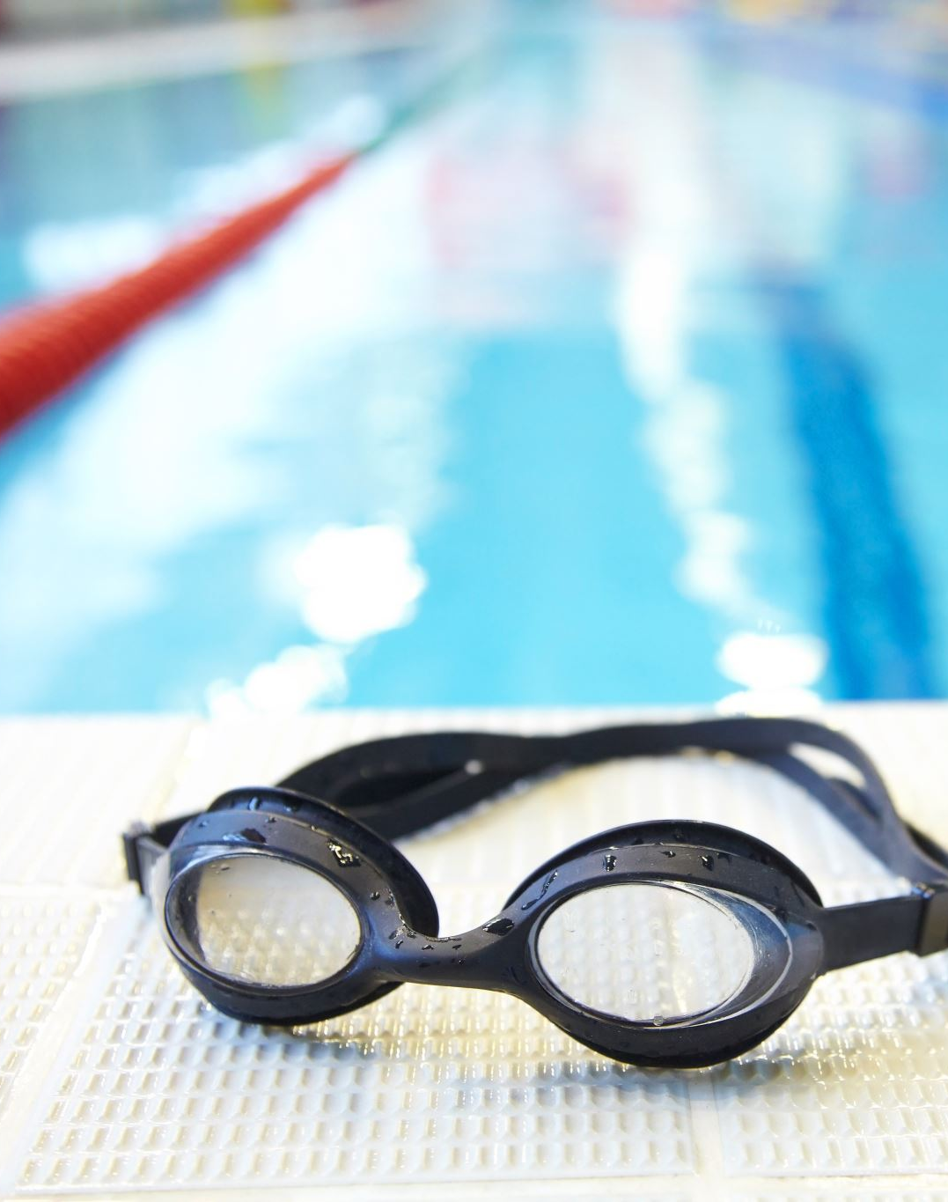
Swimming clothing
Wet suit:
The meaning of a wetsuit is to be insulated with thermal heat to ensure Darnell doesn't catch cold. It is made of neoprene, which traps a thin layer of water between the suit and the skin. The body then heats this water layer to maintain core temperature. Wetsuits are essential for activities like surfing, diving, and open-water swimming where the water is cold. They also offer added buoyancy which helps improve body position and reduce resistance in the water and provide protection from jellyfish stings, sunburn, and abrasions. It will allow him to move comfortably and train effectively which is crucial for him as him it is light way allowing him to perform his techniques. This can help Darnell because it will be insulated allowing him to keep the heat and not losing interest because of the weather temperatures dropping. One benefit would be its increases buoyancy which allows him to float higher and improve his speed. One limitation is warm water restrictions where they may find it uncomfertable.
Goggles:
Goggles are effective for swimming and are crucial in Darnell's routine because create a watertight seal around the eyes preventing direct contact with harsh pool chemicals like chlorine which can cause stinging, redness, dryness, and irritation. They also protect eyes from saltwater, bacteria, algae and other debris found in natural bodies of water. Darnell is not equipment with clear vision under water which he will need goggles to stop any irritation. The goggles provide an air pocket around the eyes eliminating blurriness and allowing swimmers to see clearly. This will allow him to move more comfortable as his eyes will not be stinging allowing him to carry on with his session. This will help Darnell because it will reduce strain on the neck and shoulders. One benefit would be eye protection creating a line stopping chlorine going in allowing him to keep going without any interruptions. One limitation is eye pain this is where there is too much pressure around the eyes.

Slide 4
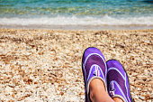
footwear
Water shoes:
One piece of footwear would be water shoes. They can protect the feet from any sharp objects in the water that they cannot see and can could cause injury. Water shoes feature rubber, anti-slip soles designed to provide superior grip on wet and slippery surfaces, such as pool decks, boat ramps, and mossy rocks, reducing the risk of slips and falls. They are typically lightweight and made from quick-drying materials like mesh and neoprene that prevent the feet from getting waterlogged ensuring comfort both in and out of the water. In public pools and changing areas, they provide a protective barrier against germs and bacteria helping to prevent infections like athlete's foot. These can instal thermal insulation preventing the feet from becoming cold. This will help Darnell because it will give him grip allowing him to keep his balance. One benefit would be it has extra protection as if there is any sharp objects in the water it stops injury. one limitation would be it slows down speed as its more weight on the feet.

Slide 5

Safety consideration
When swimming Darnell needs to take into consideration that if he has long hair, he will have to tie it back and place it into a swim cap. This will allow to prevent any covered vision getting in his way stopping him for swimming and preforming to his best ability. When a swimmer is having a practice, they should always take into consideration of who their surroundings are. The meaning by this is they should always swim with a buddy or a lifeguard around even if they are experienced as if something happens there is always someone there for support. When entering the swimming baths, they need to take into consideration of the rules and regulations and their baring's as if anything ever happens, he will know what to do. When trying to reach his limits he needs to know when to take a break and when his body is ready to finish as if not, he may be out of practise and must have time off to give his body time to recover. Id Darnell is married and has a wedding ring he need to make sure to take it off befor entering the swimming pool as if not it may get lost and that is a lot of money to lose.

Slide 6
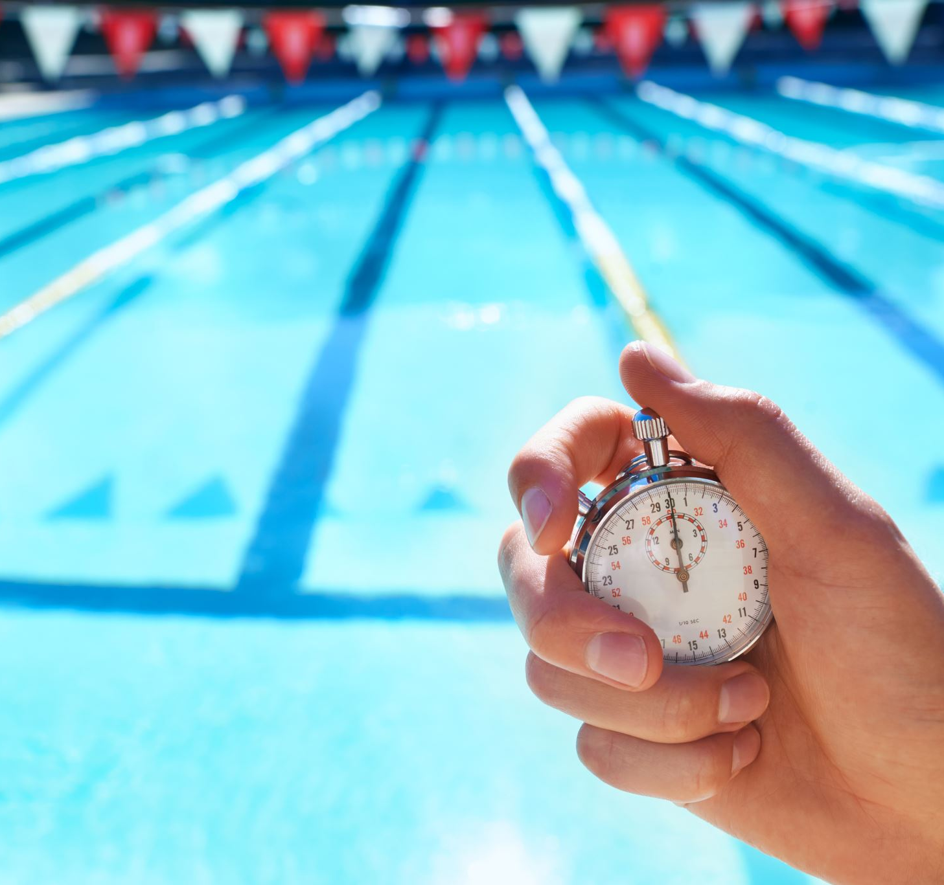
Technology in swimming
Pool timing system:
Darnell could use a pool timing system because it allows him to see his progress and the speed, he has been doing so each day he can set a goal to beat his last session. The benefit of this technology is that it helps him to ensuring fairness and accuracy in competitive swimming, as it provides precise times for ranking and determining results, especially in close races where milliseconds matter. This technology allows Darnell to track or improve his speed as he can see what he has done previously and push himself to increase it each time. A limitation for this technology would be him seeing his process and taking too much on himself to beat it allowing his body to be out beaten and need time to recovery making his practise delayed. This can help Darnell as he can see his progress. One benefit is its accuracy allowing him to get the correct results. One limitation would be not accurate timing allowing him to think wrong.

Slide 7
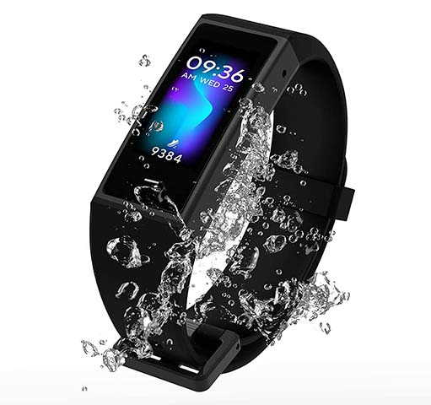
Technology in swimming
Smart watch:
Darnell could use a smart watch because it will benefit his progress allowing him to keep track of his improvement. The benefit of this technology is that it helps him to automatic coaching and tracking tool, providing data that helps swimmers monitor progress, structure workouts, and improve technique and efficiency. This technology allows Darnell to track or improve his calories that have been burnt allowing him to improve his body health. A limitation of using this technology is that its vulnerability to chemicals and high-velocity water, potential inaccuracies in tracking data, and the need for proper post-swim maintenance.
ThePhoto by PhotoAuthor is licensed under CCYYSA.

Slide 8
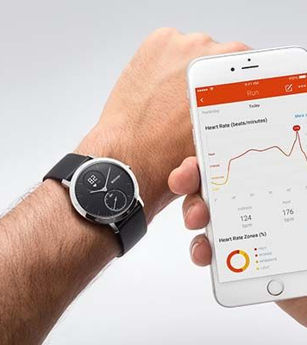
Technology in swimming
Heart rate monitor:
Darnell could use a heart rate monitor because he can see if he is pushing himself too much and his body may want to shut down. The benefit is that it helps him to objectively measure training intensity, which helps swimmers personalize their workouts, track progress, and avoid overtraining. This technology allows Darell to track or improve his quantifying workout intensity and personalizing training zones. A limitation of using this technology is that device accuracy and fit in the water, the physiological differences between land and water exercise, and challenges with real-time data visibility.
The Photo by Photo Author is licensed under CCYYSA.

