Slide 1

Hair Heaven
Revitalize, rejuvenate, and reveal your hair's true potential with our luxurious hair oil.
Notes:
Hello, my name is Harman and I'm here to present my product which is hair oil. My projected profit is £193.93 which is my gross profit and my net profit which is £145.93.

Slide 2
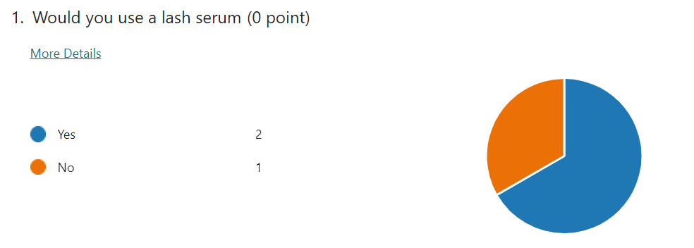
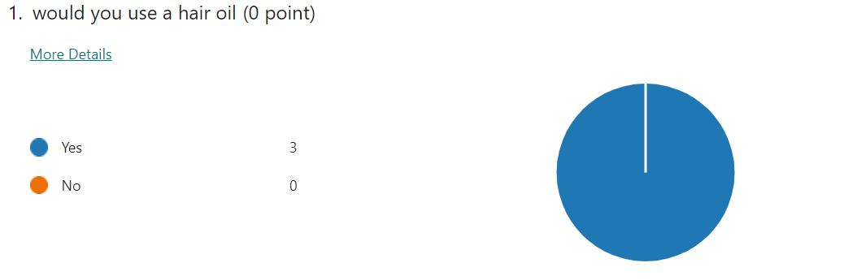
My 2 business ideas
Notes:
I did questionnaires for my 2 business ideas to see which one would be more successful and get me customers. In the first image I asked if the person answering the question would use a hair oil and all the answers were yes. However, I asked the same question but asked if they would use a lash serum. There were 2 yes's and one no. According to the statistics from the questionnaire, this information tells me that my hair oil business would be more successful as people are more interested in hair oils, which is why I rejected business idea 2; lash serum. This means if I carried out my business selling lash serums I wouldn't make as much sales as I would with hair oils as there are more interest in hair oils. With business idea 2 which is the lash serum, there's too many resources needed, and because of the economy, prices are going up and this is risky for business idea 2. Business idea 2, to make the product it costs more than Business Idea 1 which is the Hair Oil and I only have a £50 budget for my business

Slide 3

Information about me and my business
Notes:
The ownership is sole trader as I'm the only one running my business alone. I am not allowed employees due to my age however family and friends can help, and my budget is only £50. A sole trader also has a flat internal structure. A sole trader also has an unlimited liability which is when if I go bankrupt, I may lose all my personal possessions. My primary target audience is 14-16 year olds. My secondary target audience is 18+. The reason for my identified target audience is that most teenagers at the age between 14-16 years old care a lot more about their appearance and this product will help them and make them feel better and more confident. I also have financial and non financial aims. My financial one is to breakeven, but when I start to sell my product, I would like to make a profit, My non financial aim is customer satisfaction where I would like to keep my customers happy and loyal. I'm in current competition with Perfection Hair and Beauty in Tipton, Great bridge who have good reviews/ratings.

Slide 4

Finance
Notes:
I know my business will be successful as my breakeven output is when I sell 2 bottles of my oil I can make a profit afterwards. I also conducted a cash flow forecast for 12 months. I did this by looking at my inflows which is my sales revenue and my outflows which is all the money I'm paying out (raw materials and phone bill). I also looked at my net cash flow and looked at my opening balance which is £50 as that is my budget. I also looked at my closing balance. I made a profit and loss account which is where I looked at my selling price which is the cost to make my product, my monthly sales which is how many sales I make, monthly expenses which is how much I'm spending, my sales turnover which is my inflow, and then my cost of sales. I worked out that my gross profit is £193.93 and my net profit which is £145.93. For my margin of safety in month 6 (June) my number of sales would be 3 as my breakeven is 2 sales and I originally predicted 5 sales for that month. The pricing strategy I will be using is psychological. This is when you use, your 97 or 99 pence's for example to make the product seem cheaper, for example for my product I’d put £6.99 instead of £7.00. Another pricing strategy I will be using is penetration. This is when prices are very low as a trial and start to increase when I get customers.

Slide 5

Features of my product
Notes:
My product will be a white bottle and it will have black writing on it which will say 'Hair Heaven'. My physical resources to make the product is, virgin coconut oil, virgin olive oil, dried herbs, peppermint essential oil and honey. My human resources are my family and friends who will help me run my business. My unique selling point is to make people's hair look and feel the best it can compared to how it was before and compared to other hair oils/products. My goods is my hair oil. It's good as its tangible and it will genuinely help any of my customer's hair.

Slide 6
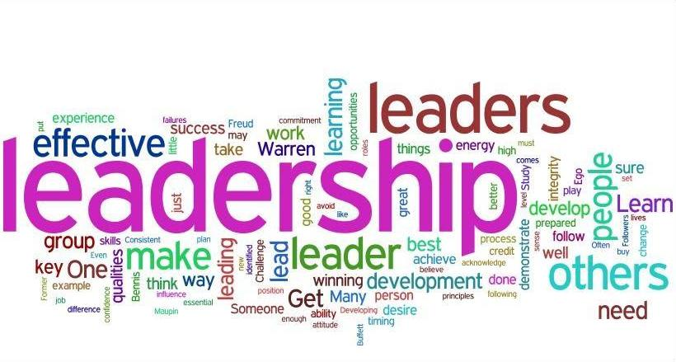
Skills and characteristics of an entrepreneur
Notes:
Entrepreneurial skills and characteristics are needed when opening up a business. I have some skills which will help me make my business successful. One of them is being passionate, I will care about what I'm doing within my business and product so I'm satisfying my customers well. Another one is being resilient, I will not give up if I ever have to deal with any problems or situations, I just need to get through them and make them right. I need to put in as much effort as possible to make sure I'm giving my customers what they want . I know I am passionate; therefore, I know I will make sure every bit of my business is treated with care as that will help make my business successful. I also know that a good product which works will keep my customers loyal and keep coming back which helps me with my financial and non financial aims, which are making a profit and customer satisfaction. Therefore, this tells me that not only will my business be a success but I will have successfully completed my aims as well. I also know that I am resilient because I want to make sure I am a successful entrepreneur who gets through their situations and problems to make things better and right. I know some people will think I'm not fit enough to be an entrepreneur if I'm not resilient enough and give up easily. This tells me that if I am resilient and do not give up, I will have that chance of my business being successful. I also need to be dedicated. I need to put in effort to ensure my business does well. I would not want to have a bad look on me if I did not put in any effort and care for my business as that is not what an entrepreneur does. If I don't put in any effort my business will be a fail and customers would not be happy if I didn't care or put in any effort within my business which is why I will stay dedicated to ensure my business will be successful. I also need to be proactive. I need to and will make improvements before things go wrong. I have done some research and found out that other entrepreneurs who have a successful business, have the skills/characteristic of being proactive. This tells me that if I also be proactive like these entrepreneurs, my business will also be a success.

Slide 7

Promotion
Notes:
I will promote my business by using social media as social media is popular for entrepreneurs to promote their business on and people around the age of my target audience use social media often. For example, I'll make a business account on Instagram and post about my product; the features, how it works, etc. However, in the future I'm hoping to have my own wider platform than I do now. Also, some other successful entrepreneurs on social media could promote my business in certain ways like reposting anything I post about my business etc. This is an effective way to promote my business as it will cost me nothing to use it. I'll also make posters and people will see it and might be interested in the product and I can also put up the poster on the window of a Hair/Beauty salon. It will cost about £15 but its okay as its under my budget. Finally, I'll also use business cards so when people buy my product they will get a business card which they can pass on to a friend or family member bringing me more customers. It will cost £2-3, so again, this is cheap and under my budget.

Slide 8

My risk assessment
Notes:
In my risk assessment, I looked at the threats faced by my business and posed by my competitors. One of them was a lack of entrepreneurial skills. This is a threat as some people have had training or experience where as I'm unable to do that because I'm still in school. A second one is advertising and promotion. This is a threat as competitors who have a similar business to me have a bigger budget, meaning they can promote their business in better ways than I can, which raises more awareness of their business. Since I have a £50 budget, I cannot do many big advertisements to promote my business. A third one is competitors. This is a threat as for example, Perfection Hair and Beauty in Great Bridge Tipton have high star ratings and excellent reviews. This is a threat as they are likely to get more loyal customers. This also means they have more experience or training etc which I don’t have as I’m still in school. A fourth one is customers. Customers are a threat to me as other entrepreneurs with a similar business to mine could gain more customer loyalty, decreasing the number of customers buying my product. Due to this, why would customers come to my business if there were other businesses that customers would be more interested in. Another reason is products. Products are a threat to me as other entrepreneurs could come up with another product like mine, with possible enhancements which could grab other customers or my customers’ attention. Due to this, other people may be interested in that product made by another person meaning I won’t get any customers and my business would fail. My final one is a lack of customer interest. Lack of customer interest is a threat because once again, other people would be more interested in other businesses/products, meaning there wouldn’t be that many interested in mine. They might want to be more interested in someone else’s business/product who has possibly had training etc.

