Slide 1
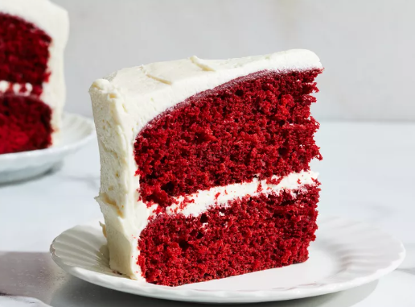
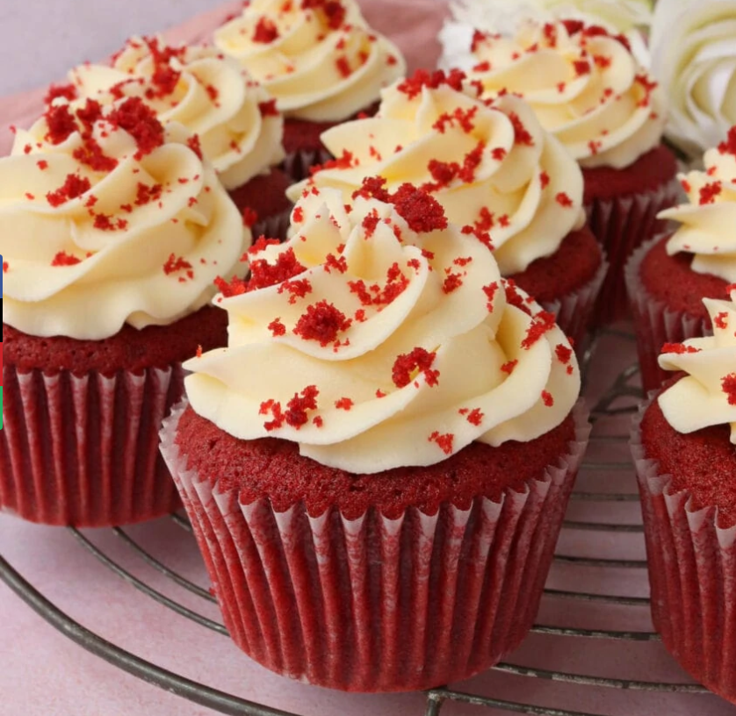

The cake gallery
With every slice is a masterpiece
By Ashleigh
Frere cupcake with every order!!!
Notes:
Good morning! My name is, and I’m excited to share with you my business idea, The Cake Gallery. This business is all about offering a wide variety of cakes that women can purchase to treat their families. The goal is to provide delicious, high-quality cakes for any occasion, with unique designs and flavours that will satisfy both customers’ cravings and their desire for something special.
When deciding between two business ideas—one centerer around a car washing service and the other around selling cakes—I conducted research to guide my decision. For my primary research, I created a questionnaire on Microsoft Forms, which I gave a sample of people in my community. The results were very promising: 75% of the sample of people indicated that they would be interested in purchasing cakes from The Cake Gallery. In contrast, only 55% said they would use a car washing service. This data helped me recognize that there is a stronger demand for cakes in my target market.
The success of my business also stems from knowing that my target audience is genuinely interested in the products I plan to sell. The questionnaire results confirmed this, showing me that my potential customers are actively looking for cake options that align with their needs and preferences. I believe that The Cake Gallery will be successful because of the clear demand for this type of service in my local community. Through both primary and secondary research, I’ve gathered valuable insights that suggest a strong market for unique and customizable cakes.
Additionally, my research into the competition revealed a gap in the market. Many local cake businesses are popular, but they often become overwhelmed with customer orders, especially on short notice. This creates an opportunity for The Cake Gallery to fill the gap by offering timely and high-quality cake options for customers who may need a last-minute order.
One of the key factors that will set The Cake Gallery apart from competitors is our focus on unique cake designs. People often look for special, one-of-a-kind cakes for celebrations, and I believe that offering custom designs will attract customers who are looking for something different than what is readily available elsewhere. By positioning my business in this niche, I am confident that I can build a loyal customer base.
As for the skills and characteristics of an entrepreneur, I know that being focused is essential to running a successful business. Without focus, it’s easy to get distracted, and I must be able to prioritize tasks effectively. This skill is something I’ve developed throughout my time at school, where I always completed my tasks in order of importance, from the most urgent to the least. Being able to stay organized and focus on what needs to be done first is crucial for managing the demands of running a business.
In terms of communication, I believe my skills are solid but can always improve. I would rate my communication skills as a 4 out of 5. Good communication is essential for any business, especially when dealing with customers. I’ll need to be clear and professional when taking orders, discussing design options, and managing customer expectations. Since communication is central to delivering great customer service, I am committed to improving this skill to ensure my business thrives.
In conclusion, I’m confident that The Cake Gallery will be a success. The demand for quality cakes, the gap in the market, and my focus on offering unique, customizable designs all contribute to a strong foundation for the business. I look forward to developing a brand that resonates with customers, and I’m excited to see how The Cake Gallery can grow in the future.

Slide 2
What the cake gallery is.
My business is a bakery where we sell cakes for any occasion
My business will allow them to have somewhere that is always profitable.
My target audience is women aged 20-40 and my secondary target audience is male 20-40 who are interested in buying my products.
Notes:
Target Audience and Business Goals:
The primary target audience for The Cake Gallery is females aged 20-40 who enjoy treating their families to something special. This age group is often responsible for purchasing family treats and celebrating milestones, making them ideal customers for my business. In addition to my primary audience, my secondary target audience includes males aged 20-40. While the primary focus will be on women, it’s important to cater to a broader market, especially as I expand and offer more products in the future.
The reason I’ve chosen this target audience is because they are more likely to purchase personalized cakes for special occasions, as well as for everyday family treats. In the future, I aim to broaden my target audience to include a wider range of customers, as this will help increase sales and revenue.
Expanding my audience will allow me to tap into the growing demand for personalized cakes, which many people are willing to pay more for. This could also help boost the business by attracting a variety of customers who are interested in unique cake designs and flavors.
Currently, my plan is to focus on selling cakes locally within my community, which is where I believe the demand is highest. However, in the future, I plan to expand by offering other desserts, such as cookies, brownies, and pies, to further satisfy my customers' needs and preferences. This will help not only grow my customer base but also support the local community by providing them with a wider selection of treats.
Research and Funding:
The research I’ve conducted shows that businesses similar to The Cake Gallery have been successful in the past, especially those that offer a personalized touch. Many customers are increasingly seeking unique and custom-made cakes, which is why I’m confident that my business can succeed. Additionally, my research supports the idea that personalized cakes have a strong market potential.
I have been given £50 to start this business, which is a small budget to work with. However, I plan to make the most of this by offering my products at affordable prices, which will attract customers who may be looking for reasonably priced options. By keeping my prices lower than some of the more expensive competitors, I will ensure that my target audience can access my products without breaking their budget. This will help me establish a loyal customer base, as people will always know they can find an affordable, high-quality product from The Cake Gallery.
Unique Selling Points:
One of the key reasons The Cake Gallery will stand out is due to our unique selling points (USPs). Firstly, I am using my own family recipes to create cakes that have been passed down through generations. This ensures that each cake is made with love, tradition, and quality, which will resonate with customers looking for something special and homemade.
The authenticity of these recipes sets my business apart from others in the market, and it ensures a consistent, high-quality product.
Another unique offering from The Cake Gallery is the addition of cupcakes with every order. With every purchase, customers will receive a free cupcake as a little extra treat. This not only adds value to their purchase but also helps create a memorable experience for the customer. I believe that these personalized touches will foster loyalty and encourage repeat business.

Slide 3
Ownership of my business and financial and non-financial information
The ownership is sole trader.
Financial aims: My financial aims are to break even while my budget is £50, I want to be able to make this money back throughout my business and I also want my customers glad that they were able to buy something with guaranteed quality for just a substantial value.
Non-financial aims: I would like customer satisfaction which will keep my customers loyal so they can keep coming back. I would achieve this by using resources that are eco-friendly which would cause a positive impact with my costumers.
Notes:
A sole trader has unlimited liability. Unlimited liability is where if you go bankrupt you may lose your personal possessions. This would impact on my business because it is a risk with only having £50 and with my ownership being sole trader, this means that I could lose my possessions and my business could fail. A sole trader has a flat internal structure, and I am the owner, but I cannot employ staff because I am underaged, but I can have family and friends to help.
My financial aims are to break even while my budget is £50, I want to be able to make this money back throughout my business and I also want my customers glad that they were able to buy something with guaranteed quality for just a substantial value. To start of my business, I am going to sell my product online as I will not be allowed to buy a building/ rent a building, so I am going to run my business from home. Also, I am only going to be able to do collections as I am still in school so my business will be running after school and during the weekends.
I would like my customer to be satisfied which will keep my customers loyal so they can keep coming back. I would achieve this by using resources that are eco-friendly which would cause a positive impact with my costumers.
I know that there is a gap in the market and demand for all my products because many other businesses are so popular and busy so I know with guaranteed quality and better prices I believe that customers will buy from my business. However, with cheaper prices and with cost of living rising I believe that it will be a pull factor for customers and that means by selling my product I will be able to break-even more quickly.

Slide 4
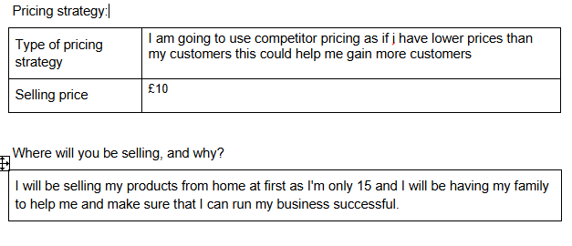
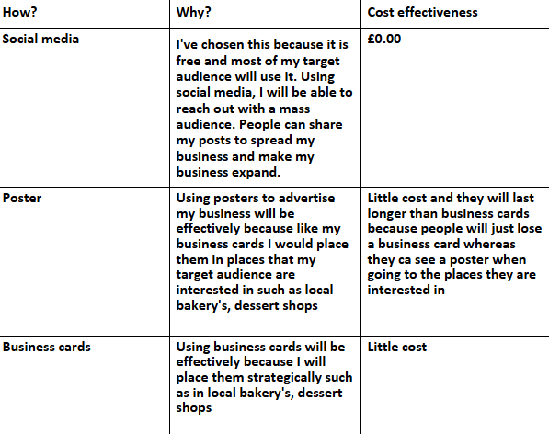
Promotional and pricing strategy
Notes:
Promotional: I have chosen these because I feel like these will help my business, but also, the way I have used these to my advantage will work. For example, the way I have placed my business cards and posters are a good advantage as I have placed them in other local bakeries.
Pricing: overall I have chosen this pricing strategy as for me starting a business I may not be able to make something in just a small amount of time and it be nice whereas when I'm like 5 months into my business I can higher my prices as it will take me less time and it will be a better quality.

Slide 5
Primary and secondary research
Primary research: Microsoft forms
Secondary research: google research and research from competitors
Notes:
The advantages of primary and secondary research:
The advantage of primary research is that you can see what clients want from you and your services also to see whether my target audience would be interested in my business.
The advantage of secondary research is that you can see your competitors reviews and see what you can improve in your business.
The disadvantages of primary and secondary research:
The disadvantage of primary research is that it is time consuming as you must do your own research.
The disadvantage of secondary research is that it may not be accurate enough to use also google might not be accurate as the data is from a few years ago.

Slide 6
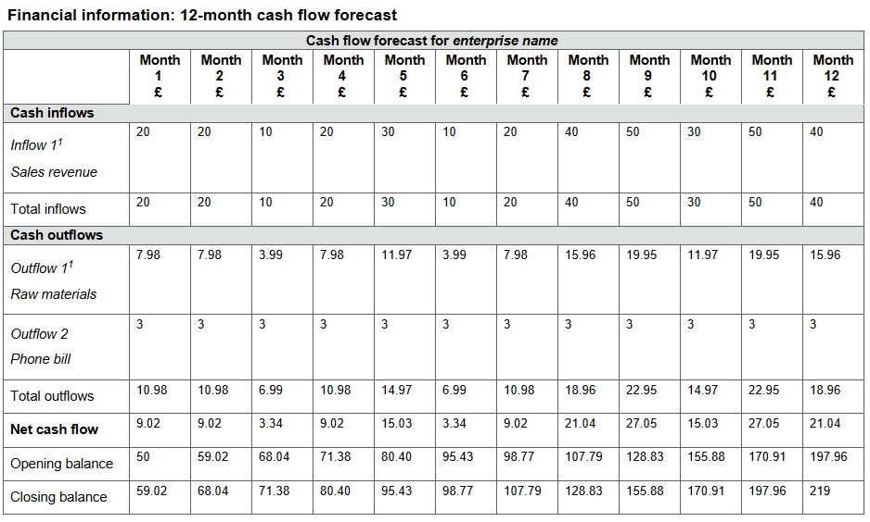
Cash flow
Inflow- money that comes in so from customers so if I can make more money by making loyal customers.
Out flow- money that I pay out such as raw materials, phone bill and repairs.
Net cash flow- total inflow minus total outflow.
Opening balance- first month it's your £50 limit, then the next month's it's your previous months closing balance.
Closing balance- open balance + net cash flow.
Pricing strategy- competitor I'm going to uses this pricing strategy because customers would come to my business because other businesses might have to many orders or might not be able to afford their service but if mine service cost less than they will come to my business also with the gap in the market and my target audience wanting this service I will get customers.

